Slide 1
Student Orientation
2025/26
Registry

Slide 2
Registry Services
Teams | Services provided
Academic Affairs | Secretariat Support for Academic Board & Various Committees Ceremonial functions Scholarships and Financial Assistance Course and Teaching Evaluation
Admissions | Admissions Programme promotion
Student Administration | Counter services and enquiry hotline Timetabling Programme Registration Course Registration Credit Transfer Maintenance of Student Records Documentations Examinations Student Handbook and Academic Regulations

Slide 3
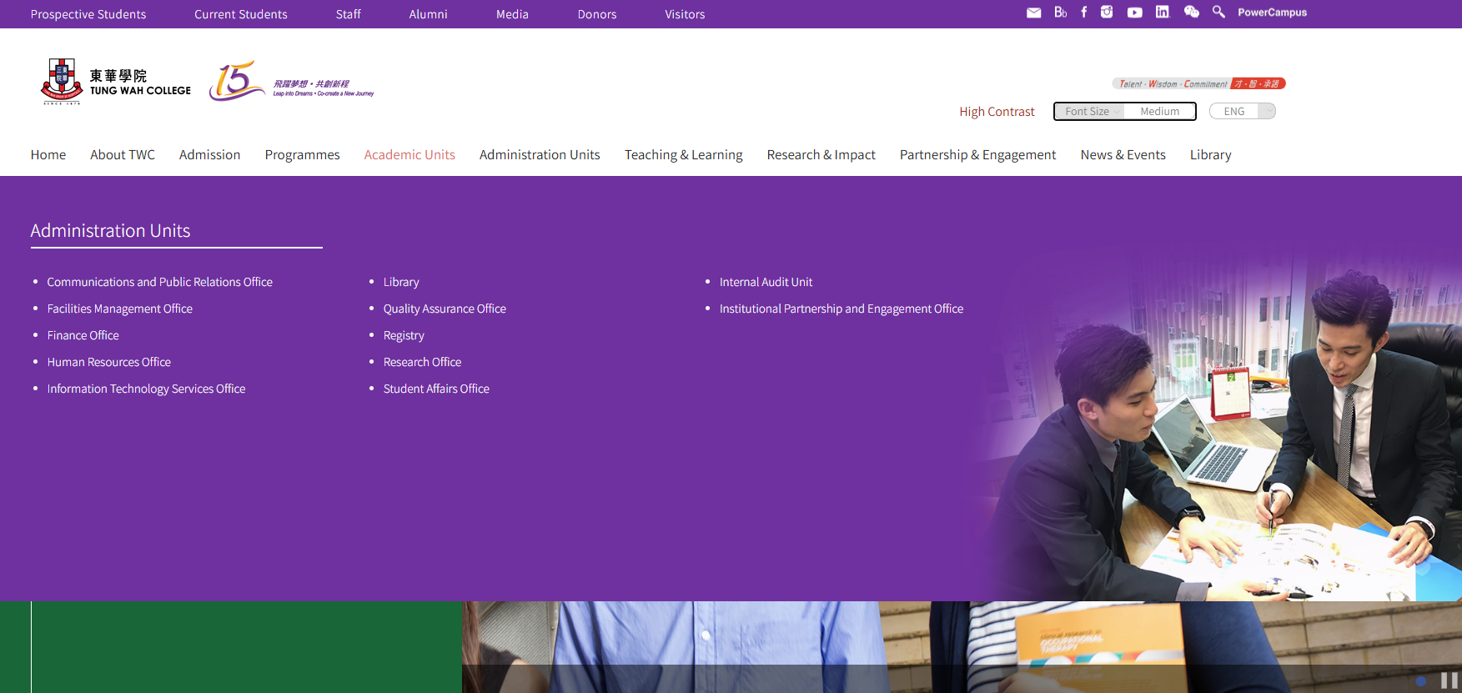
Registry Website
https://www.twc.edu.hk/en/Administration_Units/reg

Slide 4
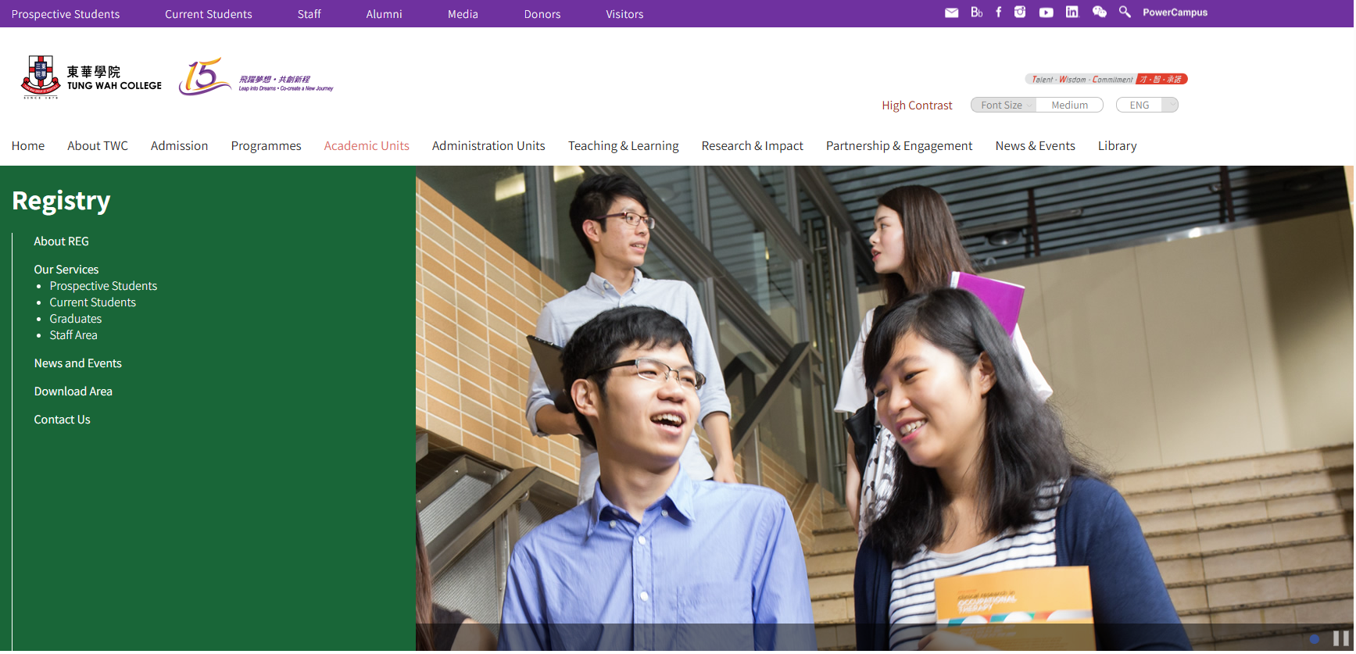
Registry Website

Slide 5
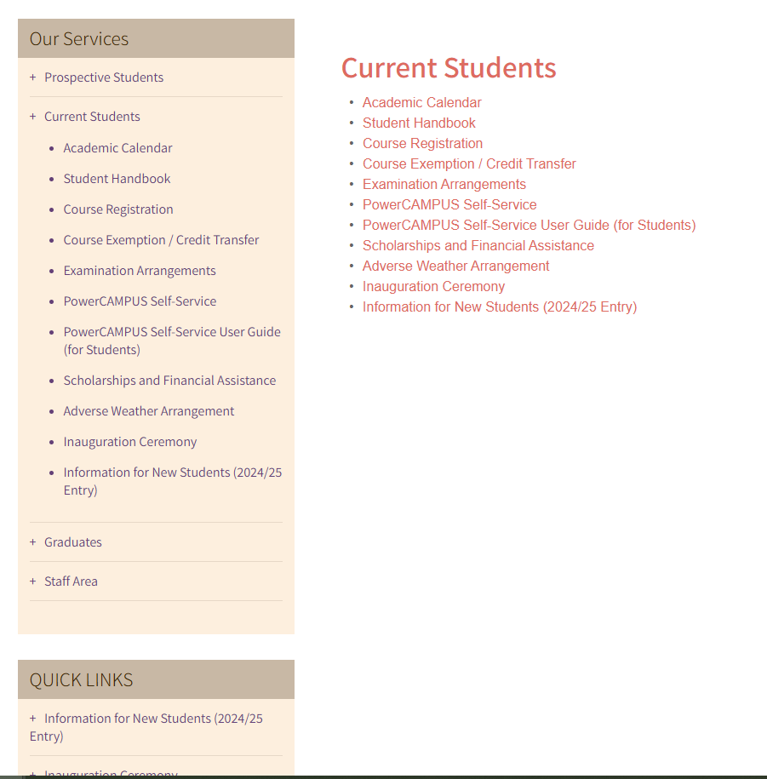
Registry Website

Slide 6
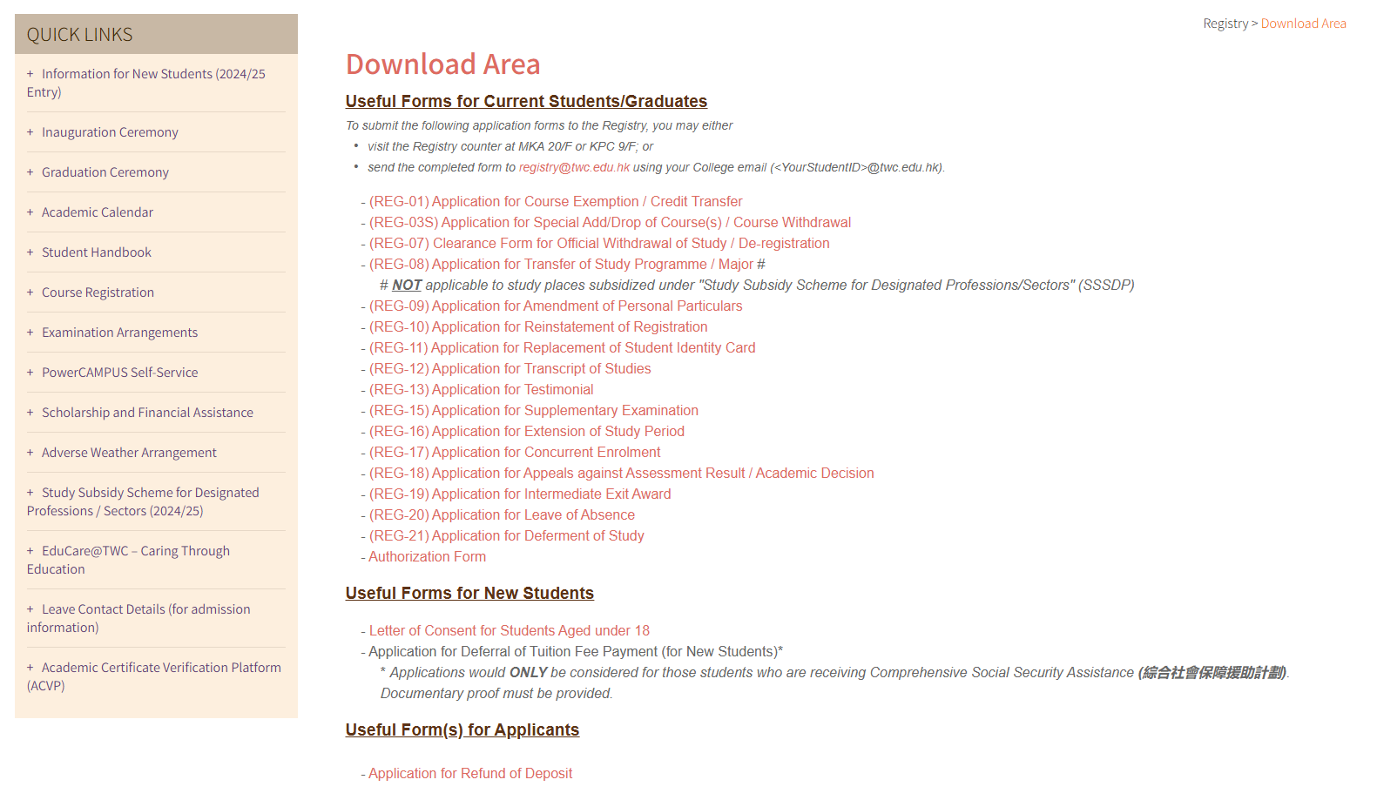
Registry Website

Slide 7
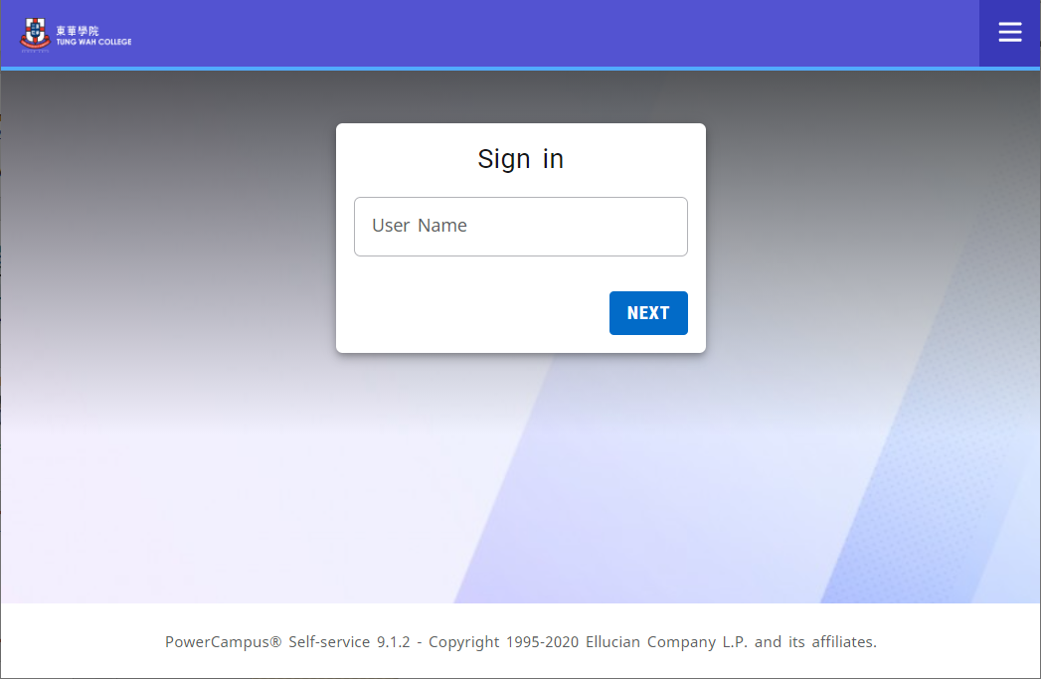
PowerCAMPUS Self-Service
https://selfservice.twc.edu.hk
Your TWC Student ID
(8-digit number)
No need “@twc.edu.hk”

Slide 8
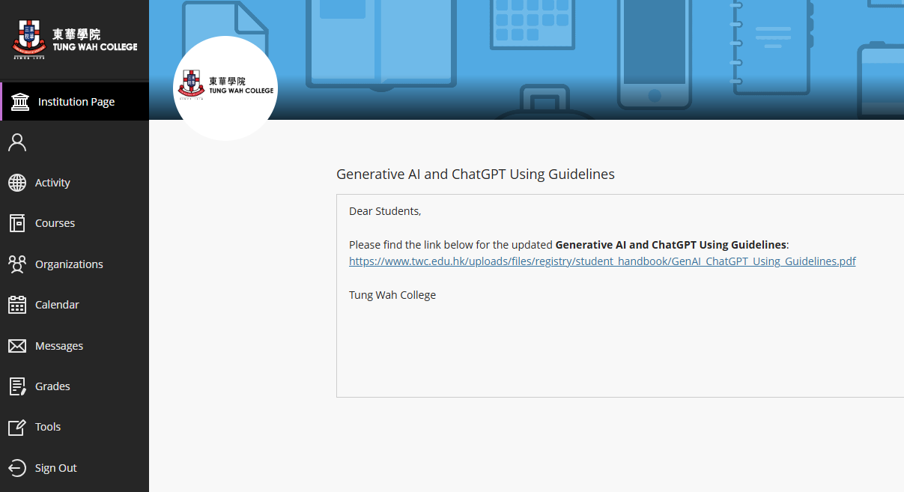
Blackboard
https://twc.blackboard.com/ultra

Slide 9
Highlights of Academic Regulations

Slide 10

Credit Transfer / Course Exemption
Previous credits earned with direct relevance
apply no later than the end of add/drop period of the 1st semester of first year of study
Additional credits earned during student exchange programmes
  apply before the commencement of the nearest semester following the attainment of additional qualifications

Slide 11
Credit Transfer / Course Exemption
For Senior Year Entrants (SYE)
Normally, no need to apply for Credit Transfer for individual courses as you were admitted with Advanced Standing and the Programme Team had considered your previous qualification

Slide 12
Credit Transfer / Course Exemption
Credit Transfer (REG-01)
Considered to have completed the course(s) concerned and granted the equivalent credits
Course Exemption (REG-28)
  Student should take other course(s) to make up for the total number of credits required for the exit award
Both Credit Transfer and Course Exemption
  Not included in Grade Point Average calculation

Slide 13

Study Load & Maximum Study Period
Two 14-week semesters (regular semesters):
Semester 1 and Semester 2
One 7-week summer semester:
Semester 3
Normally 15 credits with a minimum of 12 credits in a regular semester
Different study load for different programmes
Complete the programme requirements within the maximum period of study, i.e., Normative study period + 2 years (6 years for a 4-year degree programme; 4 years for a 2-year HD programme)

Slide 14

Course Registration and Add/Drop
Course Registration and Add/ Drop
Bachelor’s Degree (Senior Year Entry) & Higher Diploma | Starts from 9:30am, 26 Aug 2025
Bachelor’s Degree (First Year Entry) | Starts from 9:30am, 28 Aug 2025
Add/drop for Semester 1 ends at 12:00 noon, 12 Sep 2025
Check pre-registered courses before each semester starts
Perform add/drop if necessary
Late add/drop would not be accepted

Slide 15
Attendance Requirement
Under normal circumstances, not allow to sit for the course examination or may receive a Grade F (Fail) if course attendance is below 80%.
Students who are absence from all classes of all courses for 6 consecutive weeks or above without justification or notification to the Registry will be regarded as having Unofficially Withdrawn from the programme.
If you anticipate that you need to absent for a prolonged period, apply for Leave of Absence (REG-20) (for a leave period of 21 days or more, but less than 1 semester) or Deferment of Study (REG-21) (for a leave period of 1 semester or more)

Slide 16

Grading Scheme
Grade | Grade Point
A | 4.0
A- | 3.7
B+ | 3.3
B | 3.0
B- | 2.7
C+ | 2.3
C | 2.0
C- | 1.7
D+ | 1.3
D | 1.0
F | 0.0
Passing
Grades

Slide 17

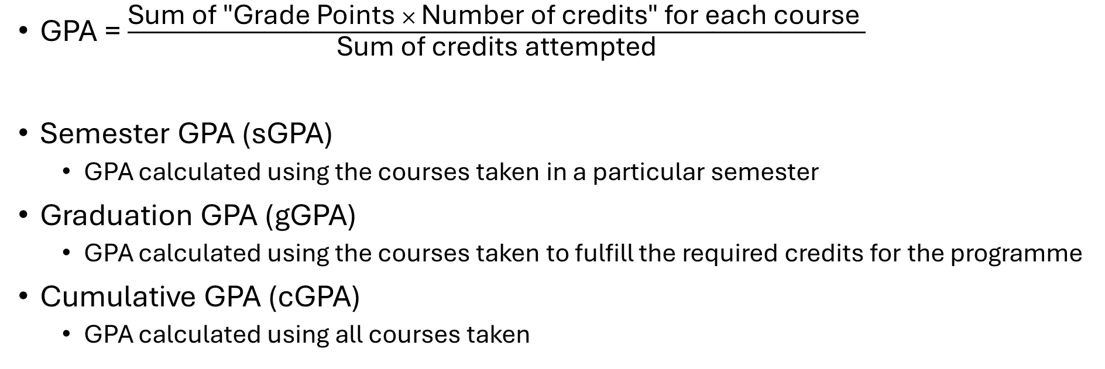
Grade Point Average
GPA = $\frac{\text{Sum} \text{of}\text{ "}\text{Grade} \text{Points} × \text{Number} \text{of} \text{credits}\text{" }\text{for} \text{each} \text{course} }{\text{Sum} \text{of} \text{credits} \text{attempted}}$
Semester GPA (sGPA)
  GPA calculated using the courses taken in a particular semester
Graduation GPA (gGPA)
  GPA calculated using the courses taken to fulfill the required credits for the programme
Cumulative GPA (cGPA)
  GPA calculated using all courses taken

Slide 18
Retaking a Course
Required to retake a course if you fail a compulsory course.
If the failed course is an elective, you may choose to retake the same course or take another elective within the programme as a replacement.
When you retakes the same course, only the grade of the latest attempt will be included in the calculation of GPA.
There are additional fees for retake.

Slide 19
Academic Probation on Progression
sGPA falls below 2.0 in a semester
put on Academic Probation in the following semester
sGPA falls below 2.0 in two consecutive semesters
put on Extended Academic Probation in the following semester
If a student on probation obtains a sGPA of 2.0 or above, the Academic Probation will be lifted.

Slide 20
De-registration of Studies on Academic Grounds
sGPA falls below 2.0 for three consecutive semesters; or
sGPA falls is 0.0 for two consecutive semesters; or
Fail the second retake of the same course (i.e., fail the third attempt);or
Fail to complete the graduation requirements within the maximum study period.
De-registration

Slide 21
Graduation Requirements
minimum required credits for the programme with a gGPA of at least 2.0
GPA of 1.0 (i.e. Grade D) or above for all courses in the programme
Graduation project / practicum (if any)
Have completed all the programme requirements (including but not limited to Work-Integrated Learning Programme (WILP) / Co-operative Education Scheme / Community Service (CS) Programme / General Education (GE) Framework
Valid score of 6.0 in IELTS Academic or equivalent*
* for degree programmes only

Slide 22

Classification of Awards
Classification | gGPA
First Class Honours | 3.50 – 4.00
Second Class Honours Upper Division | 3.00 – 3.49
Second Class Honours Lower Division | 2.50 – 2.99
Third Class Honours | 2.30 – 2.49
Pass | 2.00 – 2.29

Slide 23

Student Conduct
Violation of regulations or misconduct (e.g., cheating, plagiarism, theft, etc.) shall be disciplined by the School Dean concerned
Penalties (e.g., written warning, suspension, deregistration of studies) will be imposed by the Registrar/ Student Disciplinary Committee/Student Affairs Committee
Penalties may be kept as a permanent record for serious cases
Always act properly and be an honest person

Slide 24
Unofficial Withdrawal
A student will be considered as unofficially withdrawn from study if he/she fails to settle the tuition fee by the payment due date without prior approval.
Students who are unofficially withdrawn must complete the clearing procedures. Otherwise, transcripts and testimonials will not be issued.
Students who are unofficially withdrawn from their studies and wish to continue their study can apply for re-instatement by submitting a completed application form (REG-10) to the concerned School via Registry

Slide 25
Official Withdrawal
A student intending to leave the College prior to graduation must apply for official withdrawal by completing and returning a prescribed form (REG-07) to the Registry
Any student leaving the College without following the proper procedures will be considered to have unofficially withdrawn from the programme and will not be eligible for the refund of caution money and transcripts, testimonials and graduate certificates will NOT be issued.

Slide 26
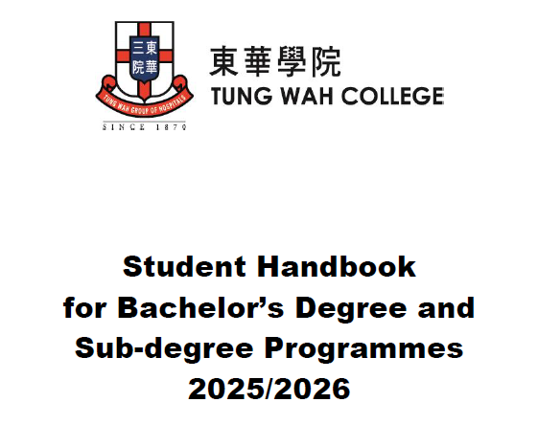
Student Handbook
https://www.twc.edu.hk/uploads/files/registry/student_handbook/Student_Handbook_20250825.pdf

Slide 27


Important Points
Keep an eye on your TWC email
Support from School / Programme / Professors / admin units

Slide 28

Service Counters (MKA 20/F and KPC 9/F)
Hotline : 3190-6673
Email : registry@twc.edu.hk
Homepage : www.twc.edu.hk/reg
Office hours of MKA 20/F
Mon – Fri : 9:00am – 5:30pm
Sat, Sun and public holidays : Closed
Office hours of KPC 9/F
Mon – Fri : 9:00am – 1:00pm, 2:00 pm – 5:00 pm
Sat, Sun and public holidays : Closed

Slide 29


