Slide 1

Welcome to TWC Library!
Library Orientation
AY2025-2026

Slide 2
ACCESS POINTS
On-site
Library at 5-6/F KP Campus
Learning Resources Centre at KH Campus
Book return (24x7)
5/F, KP Campus
Foyer@G/F, KPC
Lift Lobby@Tower B, MKC
Near the entrance of 1608A, KHC
Online help guides
e-Library (24x7) via -Library website
-TWC Search (Engine)
6/F, TST Campus

Slide 3
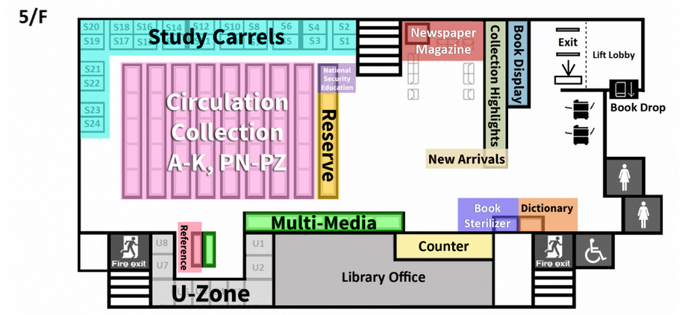
KPC Library 5/F Layout Plan

Slide 4
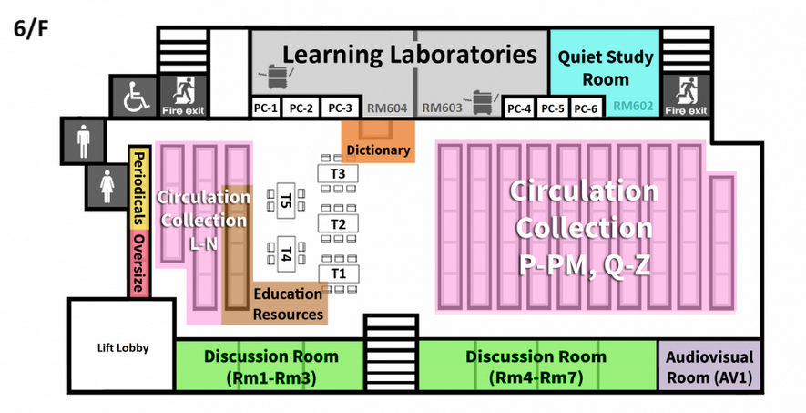
KPC Library 6/F Layout Plan

Slide 5
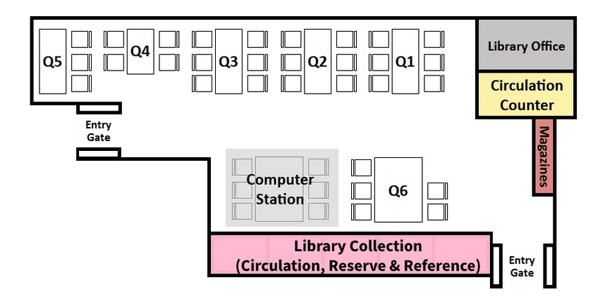
KHC Library Layout Plan

Slide 6
Physical Collection
Circulation Collection
Mainly books for normal loan
Reserve Collection
Essential readings or materials reserved for 3-Days.
Periodicals
Scholarly journals, professional and trade journals, magazines, as well as newspapers
Multi-media Collection
Mainly DVDs and DVD-ROMs

Slide 7
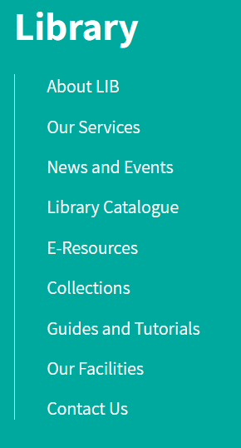
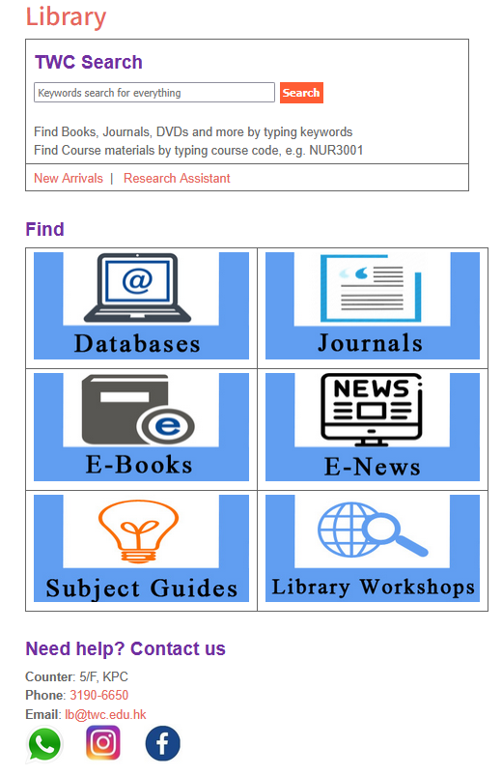
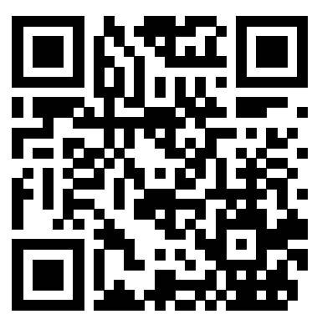

One-stop SEARCH
for all library resources
The FIRST Page covers >80% of your need!

Slide 8



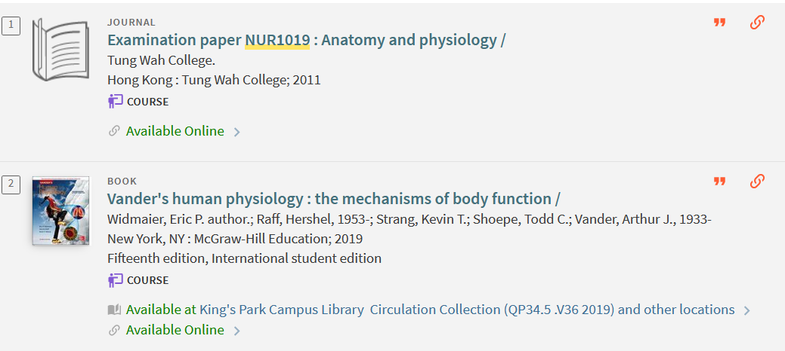
TWC Search
Course textbooks & reference materials
Type course code and search
Including both Reserve and Circulation Collection
Access point to TWC Examination paper

Slide 9
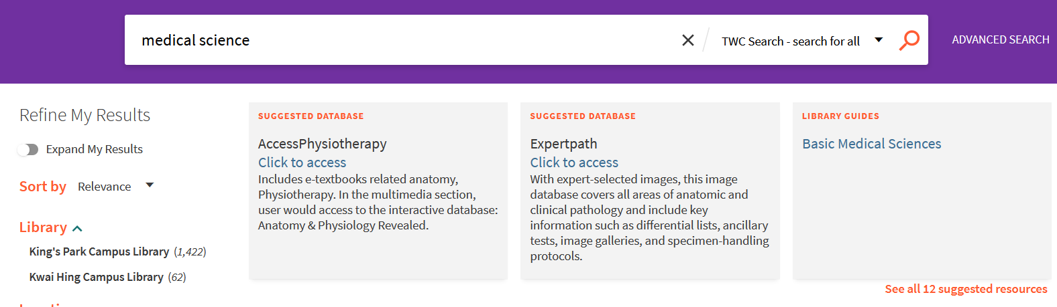
TWC Search – Subject Guide
Subject Guide
Esp. for your Major!
Try:
“Medical Science” “Nursing” “Psychology” “Management”

Slide 10

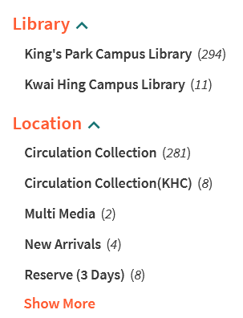
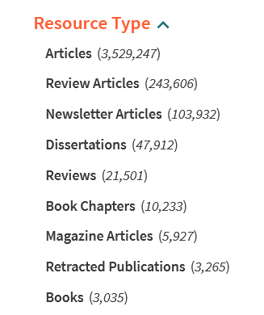
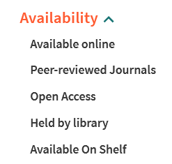
TWC Search – Filter your results
Available online
Anytime, anywhere with Internet

Slide 11
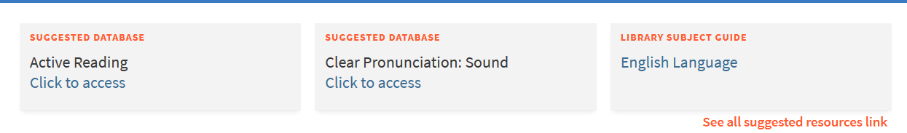
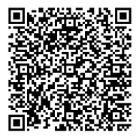
TWC Search
English Learning!
Road to IELTS
Study Skills
Writing
Pronunciation
Reading

Slide 12
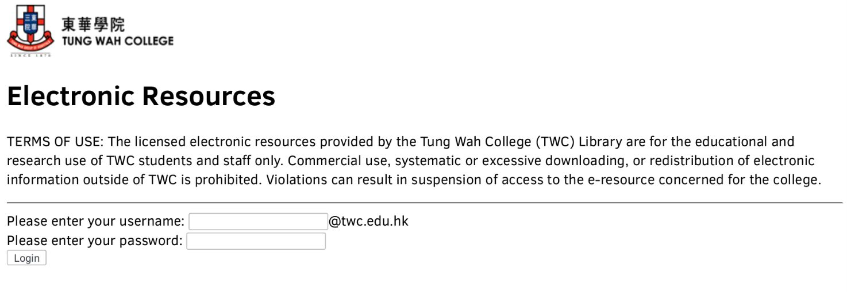
Remote access outside Campus ~ Login Details = TWC Email A/C

Slide 13
Library Orientations & Workshops
Week 2 - Week 6
Orientations: to familiarize new student with the library resources
Workshops: to introduce library services and search skills for assignments
Reference management tools

Slide 14
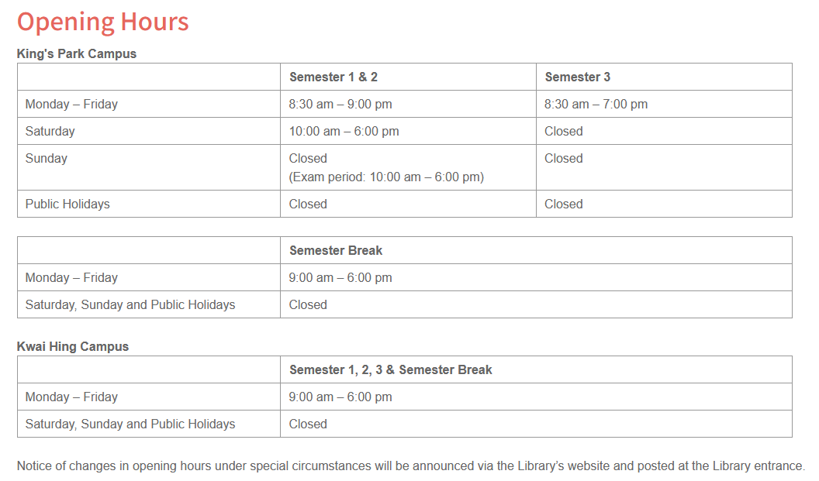
Library Opening Hours

Slide 15
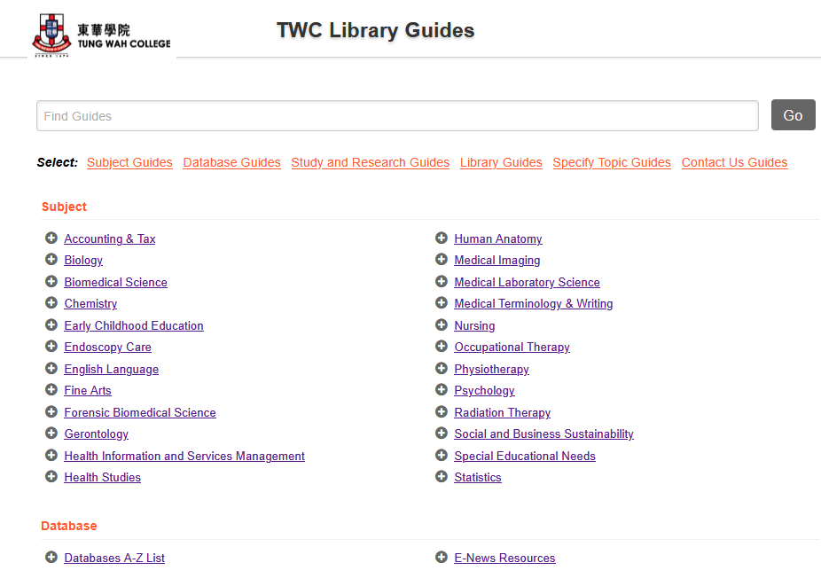
Subject Guide
https://www.twc.edu.hk/subjects_plus/subjects/#section-Subject

Slide 16

Inter-Library Loan (ILL)
Interlibrary Loan (ILL) Service is a research-support service, which helps full-time academic staff or final year students to obtain books or journal articles which are not available via TWC Library.

Slide 17
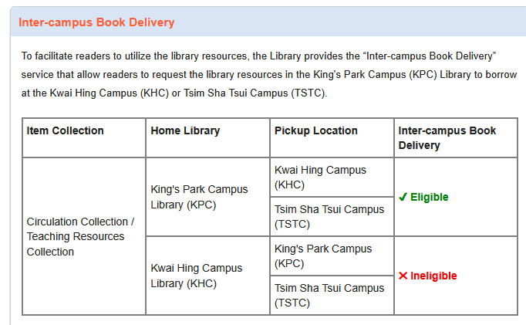
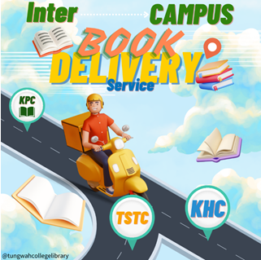
Inter Campus Book Delivery Service

Slide 18
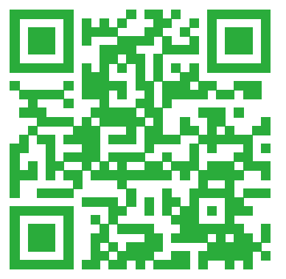


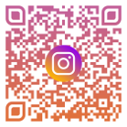
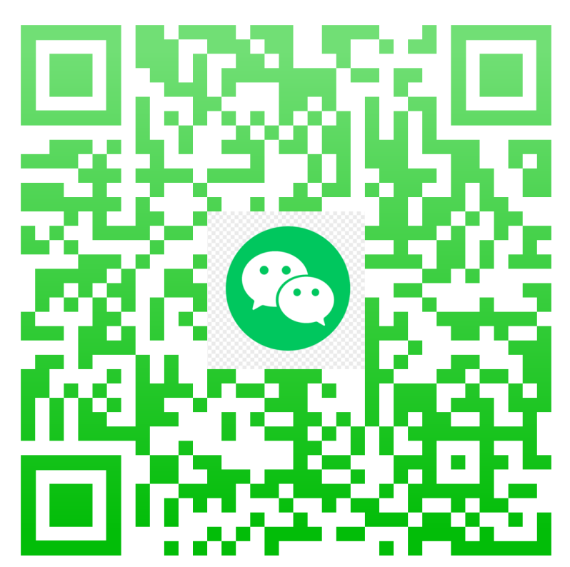
Contact us
Email: lb@twc.edu.hk
Phone: 3190 6650
WhatsApp: 5575 1564

