Slide 1

Student Orientation 2025
Information Technology Services Office (ITSO)

Slide 2
Important Message

Slide 3
Computer Account
Computer account is the basis for all IT facilities and web systems in Tung Wah College
Users must comply with Acceptable Use Policy
https://www.twc.edu.hk/itso
About ITSO -> Policies, Forms and Procedures
Do not share password with anyone or write down your password in email
Change password regularly
https://www.twc.edu.hk/changepass/

Slide 4
Update Mobile & Personal email in PowerCampus
Please help to update your mobile and personal email address in PowerCampus
Login https://selfservice.twc.edu.hk
Go to My Profile -> Personal Information
Update your personal information particularly your mobile and personal email address.
This will be useful for various activities in the College in your study life.

Slide 5
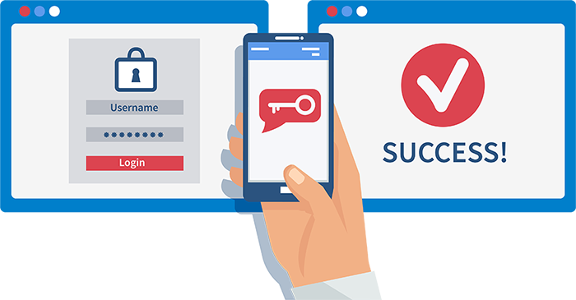
Multifactor Authentication
Enhance the protection of your Microsoft 365 account even if the password is compromised
Detail setup guide will be provided and can be found in TWC website
https://www.twc.edu.hk/itso
Help & Support -> Multifactor Authentication

Slide 6
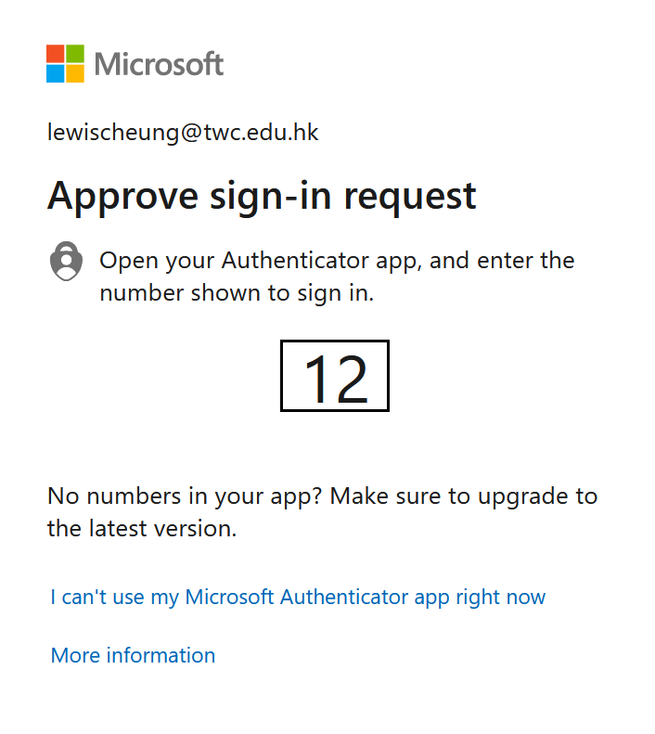

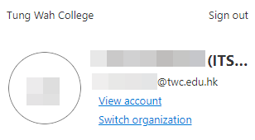
Authentication Methods Suggestion
Using the “Authenticator app” for the primary authentication method
via the Internet and it is convenient while traveling overseas.
Input your mobile number as an alternative method
In case your phone is lost or damaged, need to change the authentication method… etc.
How to Change the Authentication Methods?
Login to Microsoft 365 account (https://www.twc.edu.hk/cloud )
Select “View Account” -> “Security Info”

Slide 7

Email Communication
Email is the only official channel of communication in TWC
Do check your email everyday
Use student email for all College related communication
Do NOT use your personal email
Microsoft Outlook is the only supported client for Windows, MacOS, iOS, iPadOS and Android

Slide 8

Beware of Phishing Emails
Online Training materials can be found in the TWC website ITSO Help and Support section
Topics includes:
1. How to spot phishing e-mails?
應對釣魚電郵基本功
2. Exposing Phishing websites
識破釣魚網站
3. Beware of Virus or Malware Attacks
慎防電腦病毒攻擊
4. Beware of Business E-mail Compromise
商務電郵詐騙勿上當
Report Phishing scams

Slide 9
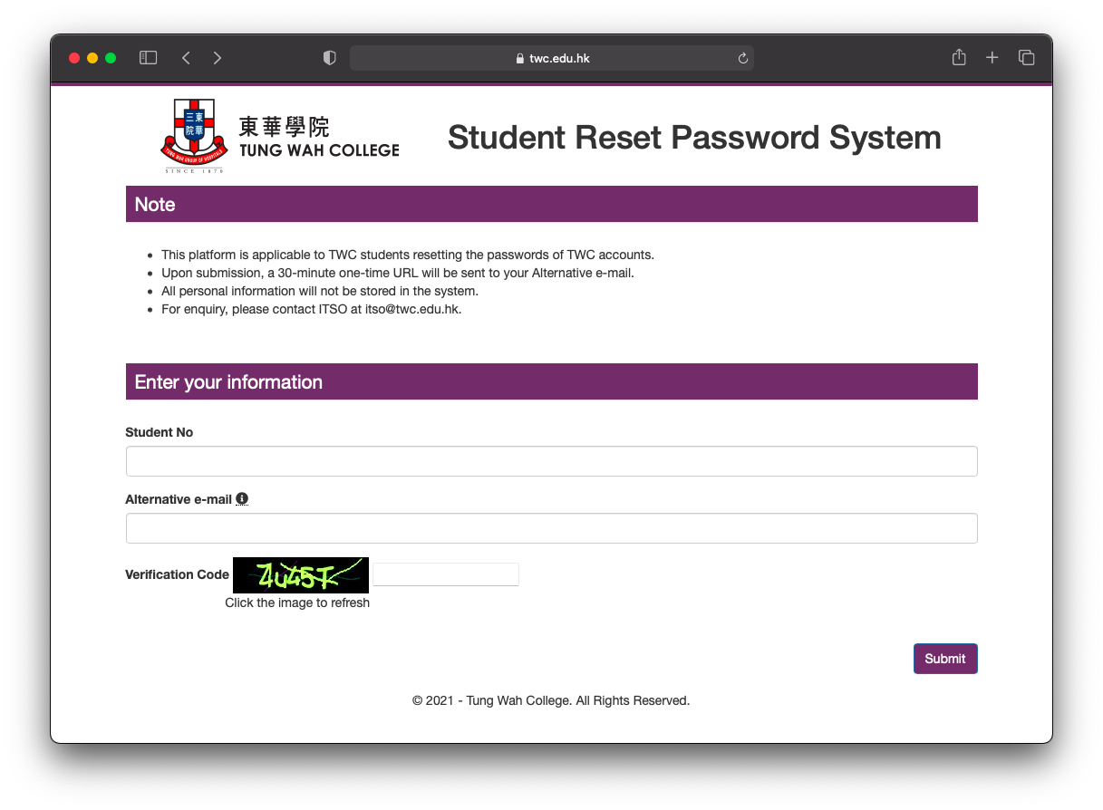
Password Issues
Account Lockout
Your account will be locked after 5 failure attempts to enter a correct password. The lockout time is 15 minutes.
Change Password
Go to TWC website -> Current Students ->
Information Technology ->
TWC Online Password Management System
Lost Password
Please contact ITSO at itso@twc.edu.hk or
Using Self Reset Password System
https://www.twc.edu.hk/stu_reset_pwd

Slide 10
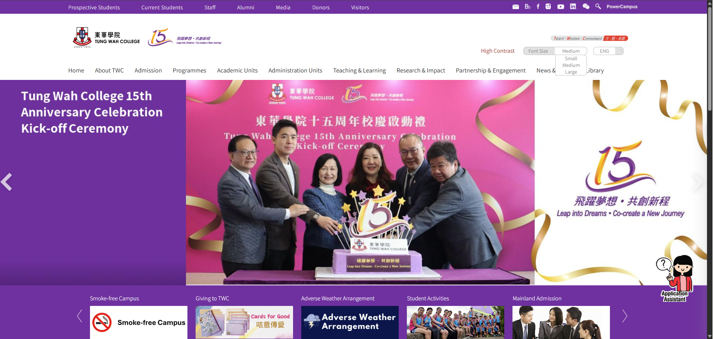

Get the Latest Information from TWC Website
Three commonly used systems can be accessed via the shortcuts here:
Outlook webmail
Blackboard Learn
PowerCampus

Slide 11
Teaching & Learning

Slide 12




Learning Management System (LMS)
Web-based course-management system
To deliver teaching materials and activities to complement face-to-face or online teaching.
Video Platform
Lecture / Class Capture
College Seminar
Share videos
Plagiarism Checking Tool
Solution for academic integrity
Similarity Report
For assignment, test or exam submission
Real-time Online Teaching Tool
Virtual Classroom / College Seminar
Engage and interact between teachers and students
Session recording feature for teachers
Run in browsers or Zoom desktop app

Slide 13
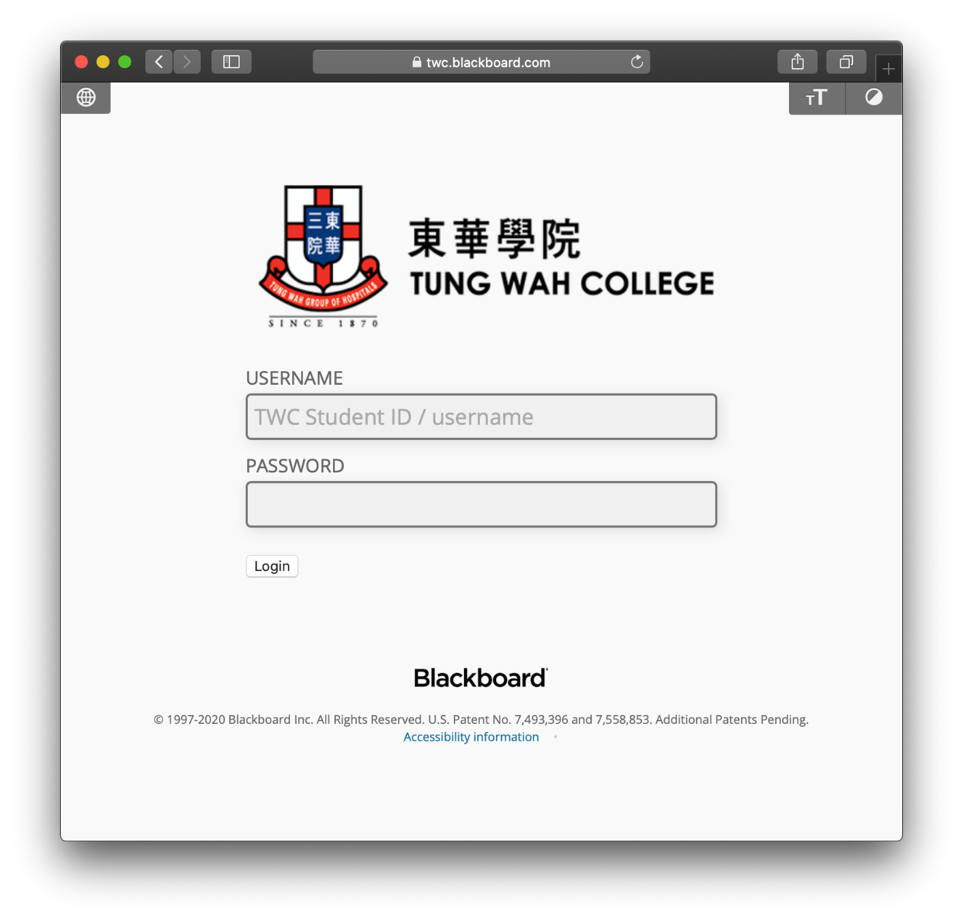


https://twc.blackboard.com

Slide 14
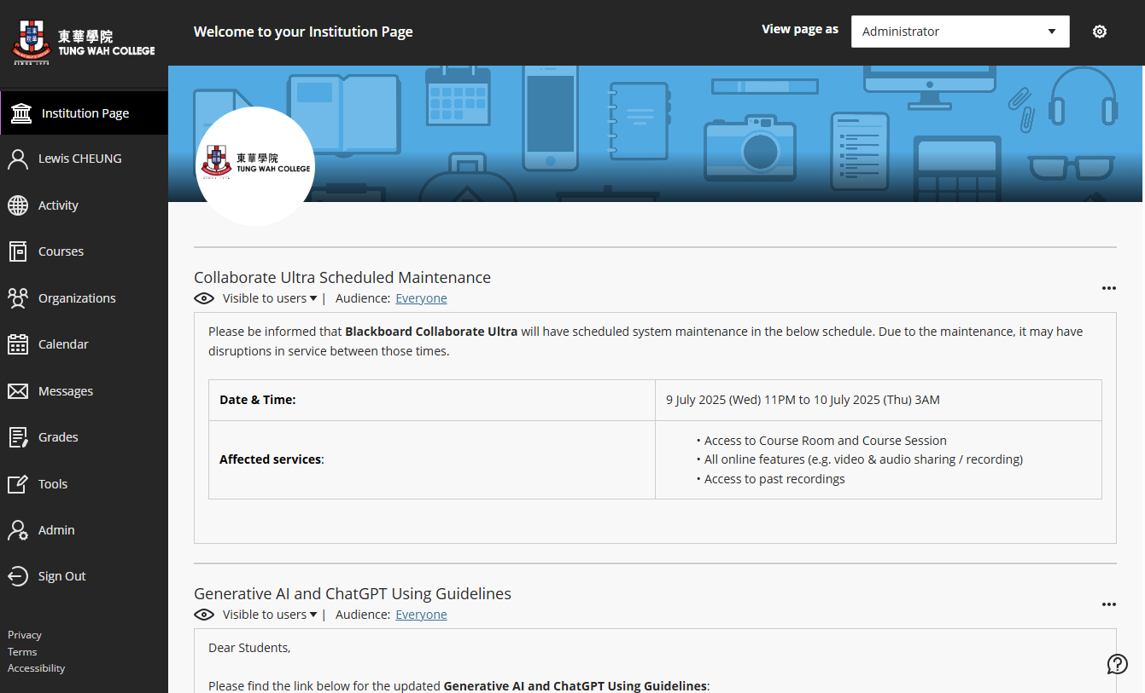
Blackboard Learn Main Page
Enrolled course will be shown under “Courses” section.

Slide 15
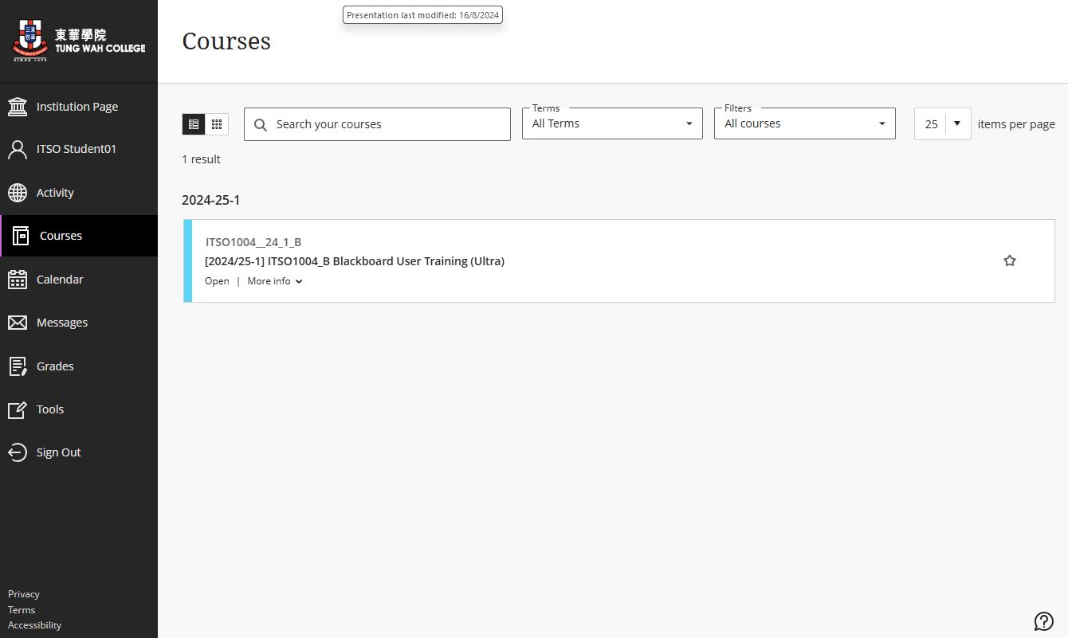
Enrolled Courses List

Slide 16
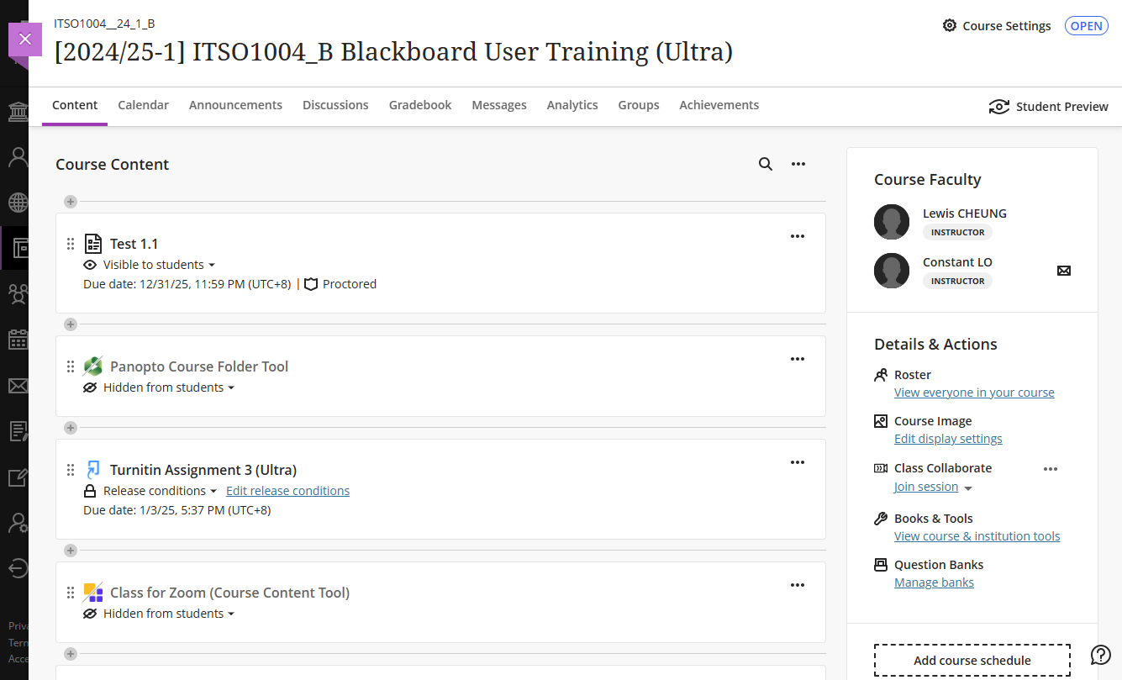
Course Home Page
You can find all teaching and learning materials under each course page.

Slide 17
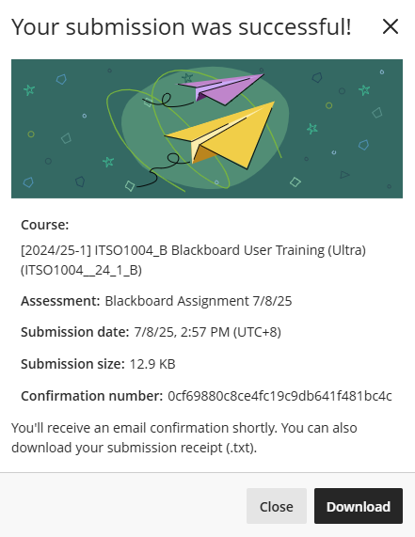
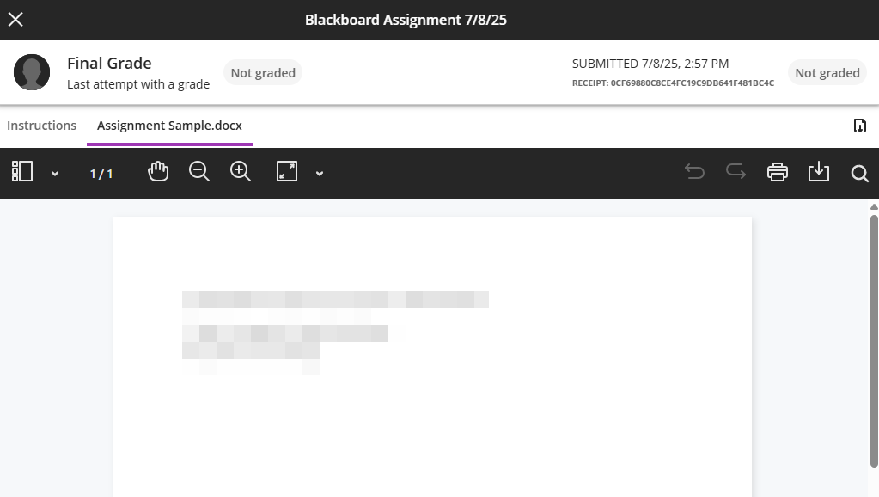
Blackboard Assignment
Keep submission confirmation number and save “Submission received” email

Slide 18
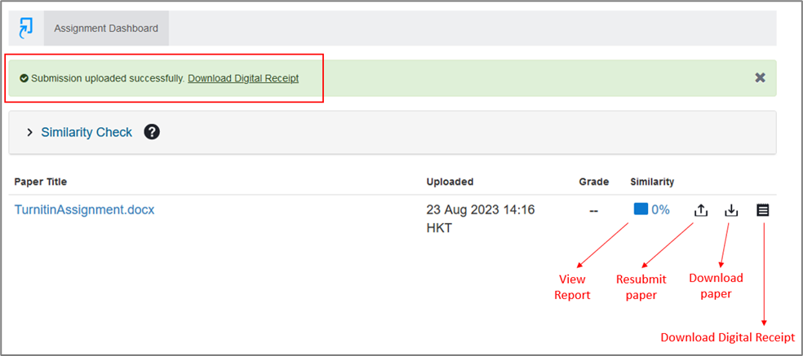
Turnitin Assignment
You can see your submitted assignment in the Assignment Dashboard and download the Digital Receipt as a backup

Slide 19
Turnitin Assignment
Submission is a formal submission, it’s not a trial.
Timing for Similarity Report generation: (if re-submission is allowed)
The first three resubmissions will generate a new Similarity Report straight away. After three attempts, a 24-hour wait is enforced to generate Similarity Reports for all subsequent resubmissions.
If you have submitted the assignment before deadline, you are not allowed to submit the assignment again after deadline even if the assignment allow late submission.

Slide 20
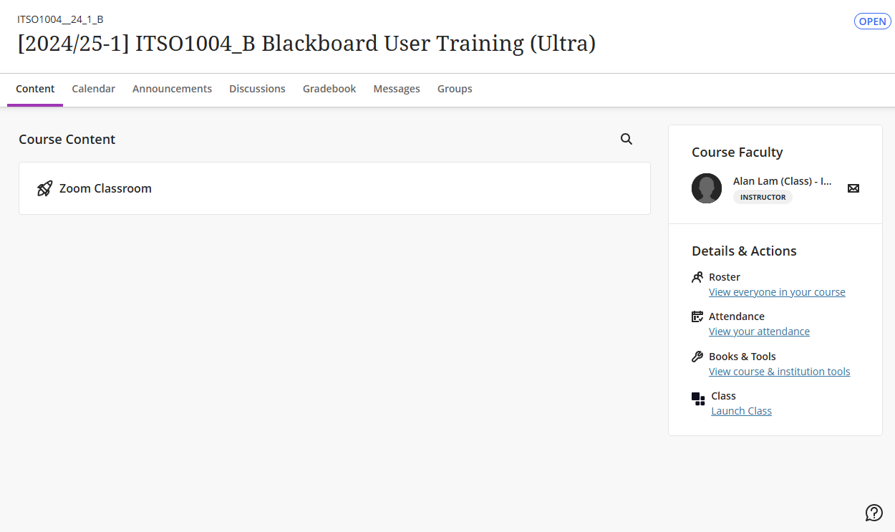
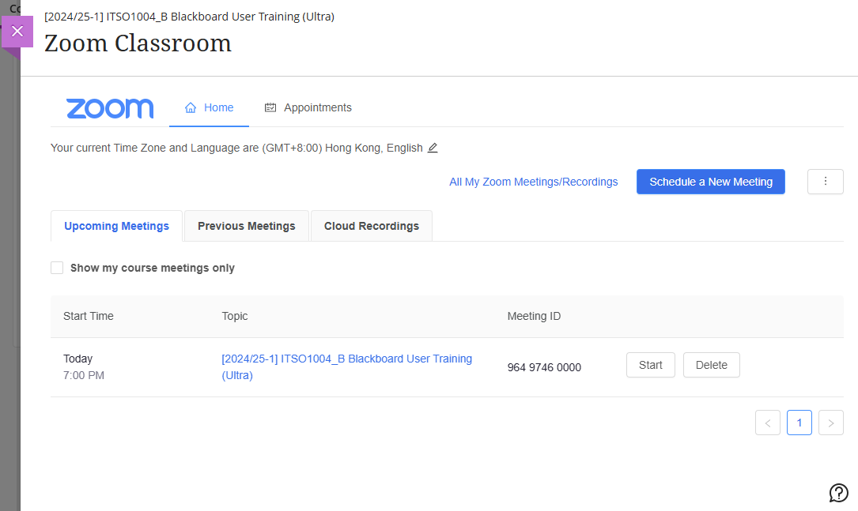
Zoom Classroom

Slide 21

Blackboard Learn Mobile App
Not all course content is supported by the Mobile App, please check here for details: (https://help.blackboard.com/Learn/Instructor/Course_Content/Mobile_Friendly_Courses/Supported_Course_Content_in_Blackboard_App)
Third-party integrated contents are required to open via desktop web browsers. (e.g. Panopto, Turnitin, Zoom, uReply …etc.)
For important events such as online tests, exam …etc. make sure to use the desktop web browsers.

Slide 22
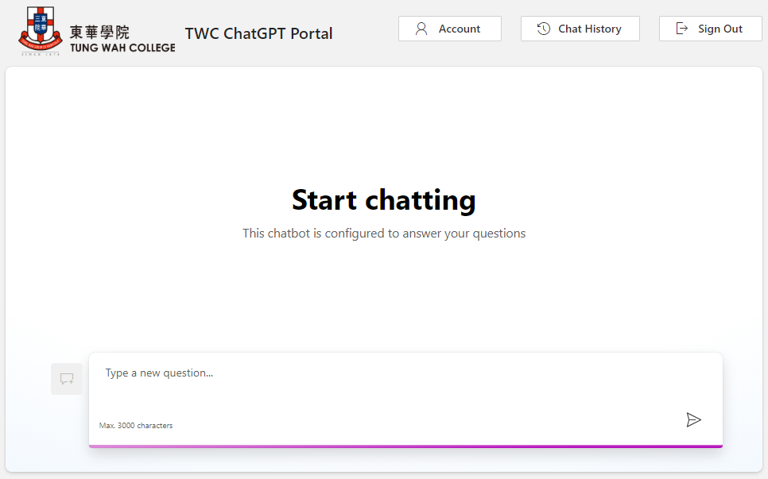
TWC ChatGPT Portal Services
ITSO provides ChatGPT Portal at https://chatgpt.twc.edu.hk based on ChatGPT version 4o and 3.5.
To use the services:
1. Login with your College account.
2. Review and accept the agreement.
Start interacting with ChatGPT.
Logout when finished using.
Key features:
1. Usage quota (100 per academic year)
Start a new conversation
Discussion history
Contact itso@twc.edu.hk for support.

Slide 23
IT Facilities & Services

Slide 24
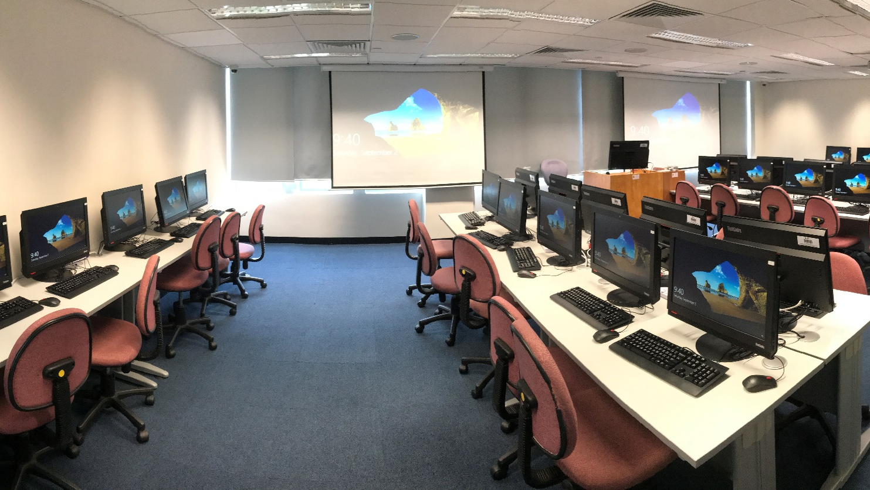
Computer Laboratories
Campus | Room | Photocopier | Opening Hours
KPC | 603 | ✓ | When Library opens
 | 604 | ✓ | When Library opens
 | 905 | ✓ | When no class
MKA | 1201 | ✓ | When no class
KHC | 1606 | ✓ | When Campus opens
TSTC | 505 | ✓ | When Campus opens

Slide 25
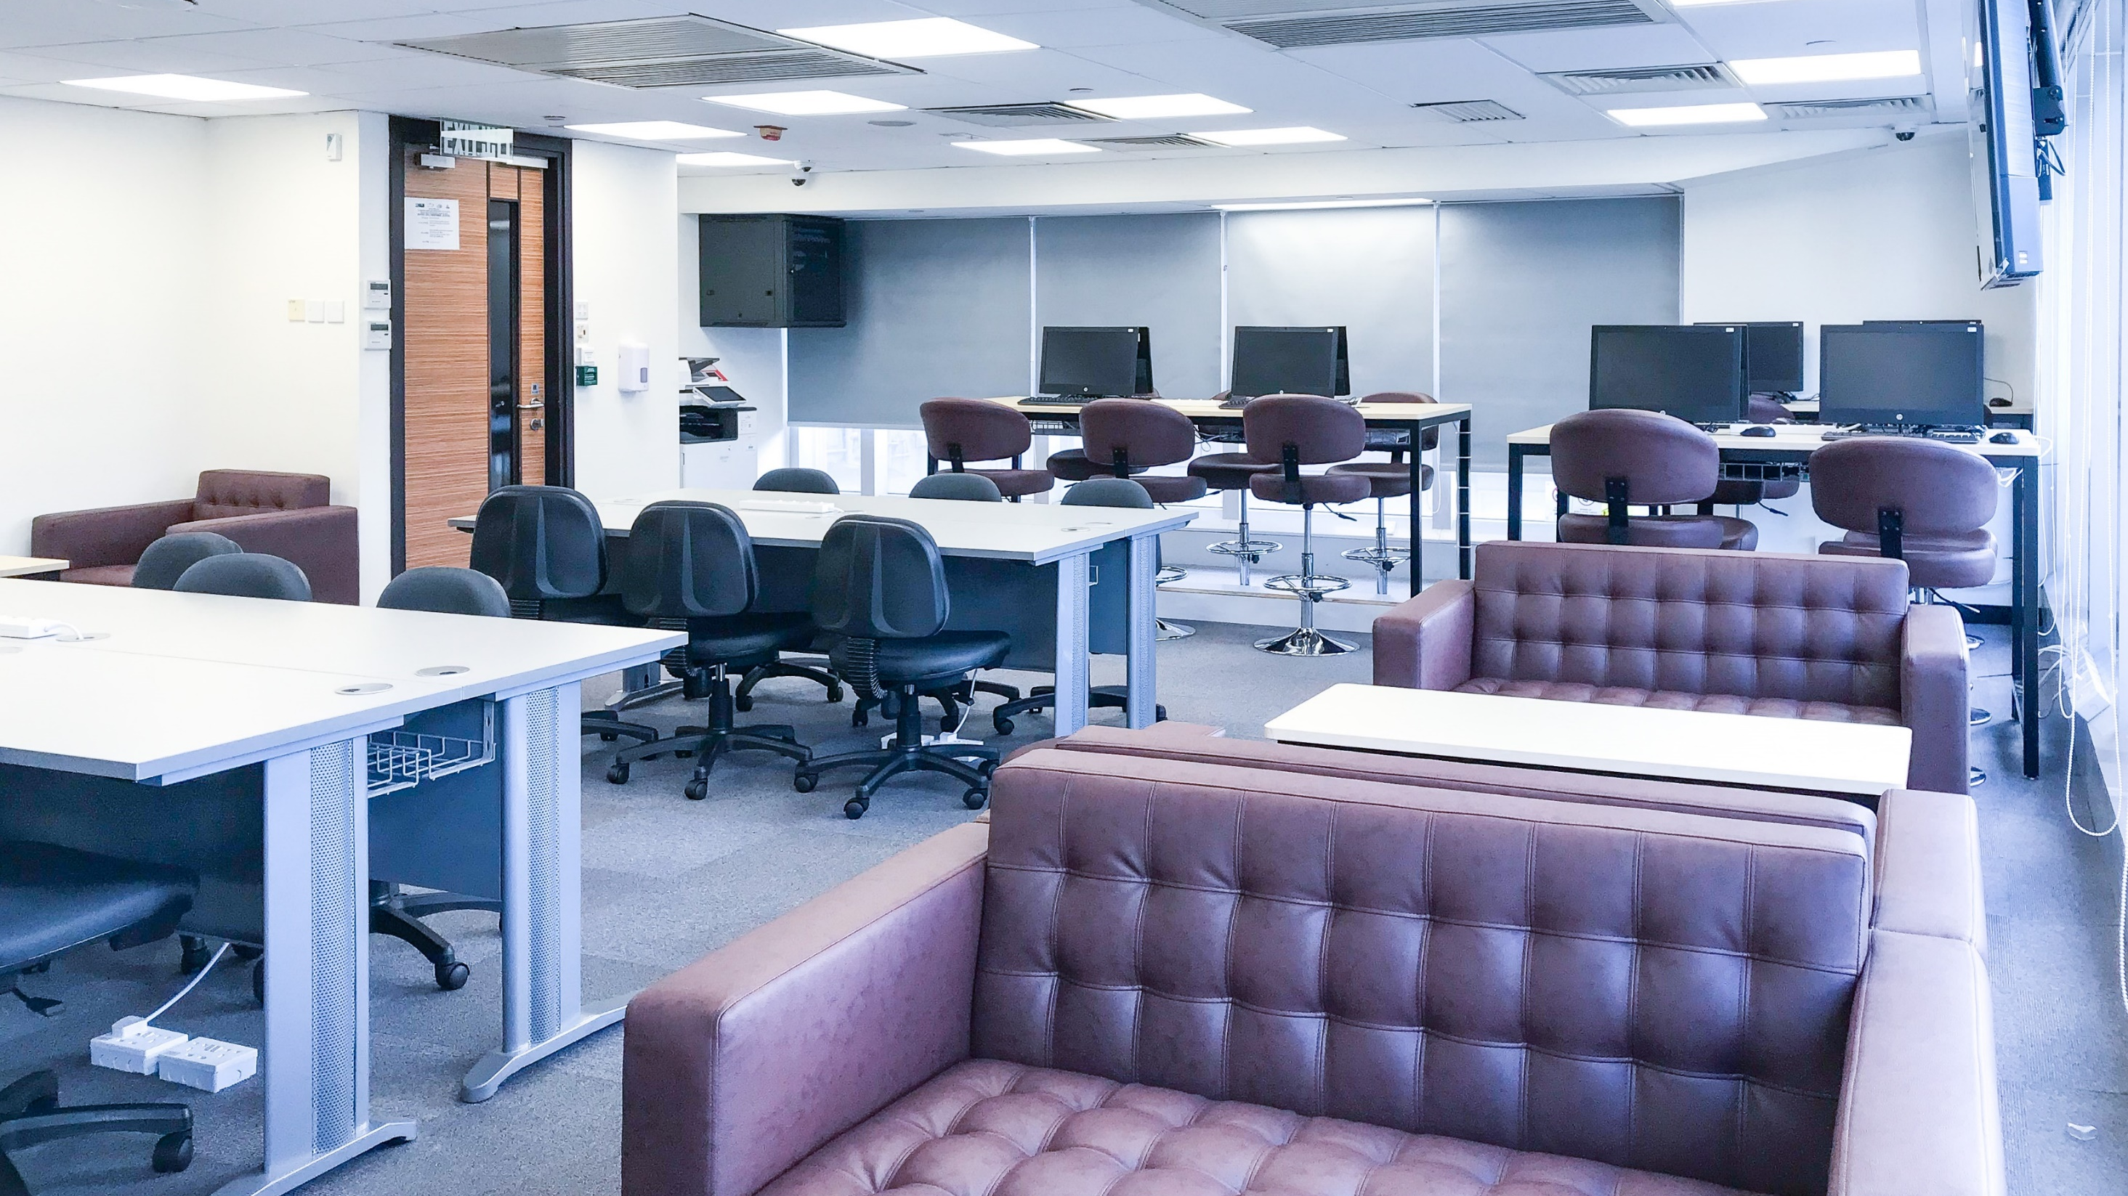
Learning Commons
Campus | Room | Photocopier | Opening Hours
KPC | 1/F | ✓ | When Campus opens
 | 7/F | ✓ | When Campus opens
MKB | 1201 | ✓ | When Campus opens
KHC | 16/F | ✓ | When Campus opens
TSTC | 203 | ✓ | When Campus opens
 | 4/F | ✓ | When Campus opens
 | 5/F | ✓ | When Campus opens

Slide 26
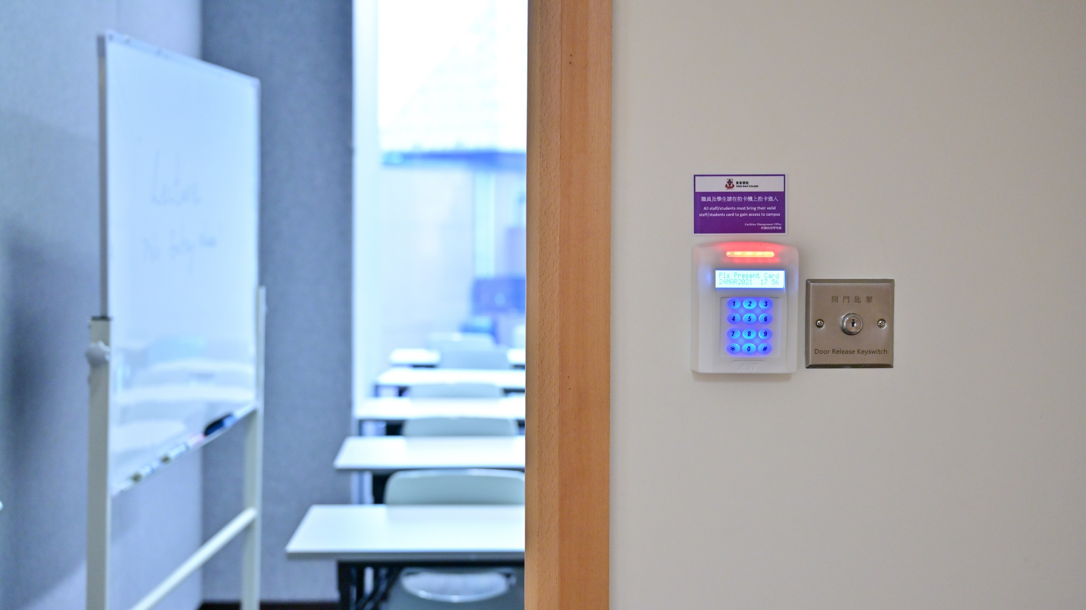
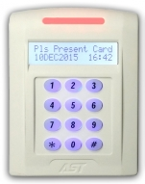
Access the Classrooms
White Colour
In normal circumstance, you can access the classrooms, computer laboratories, and learning commons by your Student ID card.
26

Slide 27
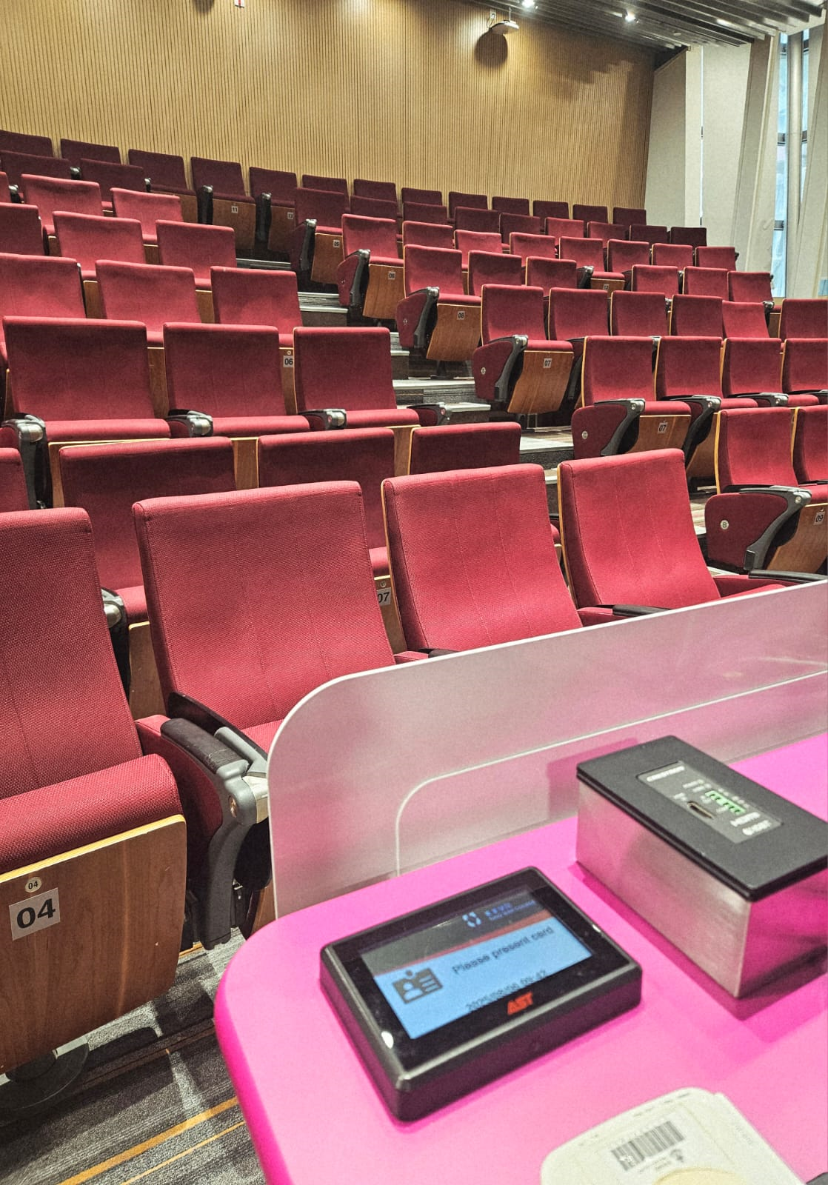
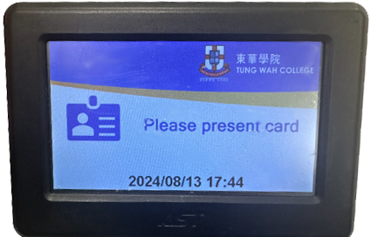
Attendance
Black Colour
To take attendance by tapping your student card on the attendance card reader (black color)
Located at the Lectern or the entrance for some laboratories
KPC Lecture theatres with additional readers at entrance
Ensure to tap the attendance card reader within 10 minutes before and 20 minutes after the class start time.

Slide 28

Wi-Fi Service
Full Campus Coverage
Use TWC_WiFi
Use eduroam when travelled to other universities
Help available at:
https://www.twc.edu.hk/en/Administration_Units/itso/help_and_support/help-wifi
Call IT Helpdesk if there is problem (3190 6640)

Slide 29
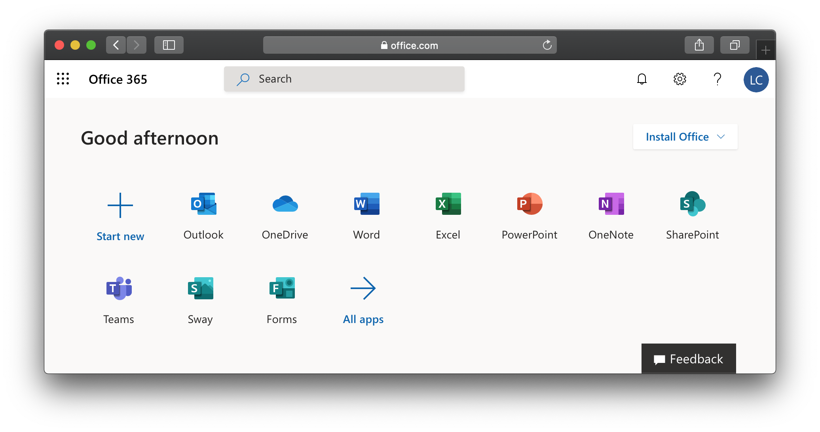


Microsoft 365
You can install office on up to 5 PCs or Macs, 5 tablets, and 5 smartphones.
Using Microsoft Outlook App for mobile, other mail clients may have authentication and stability problem.
Make use of OneDrive cloud storage for access files anywhere, back up and protect, share and collaborate.
House keeping your Microsoft account storage regularly.
To manage your Microsoft account: https://portal.office.com

Slide 30
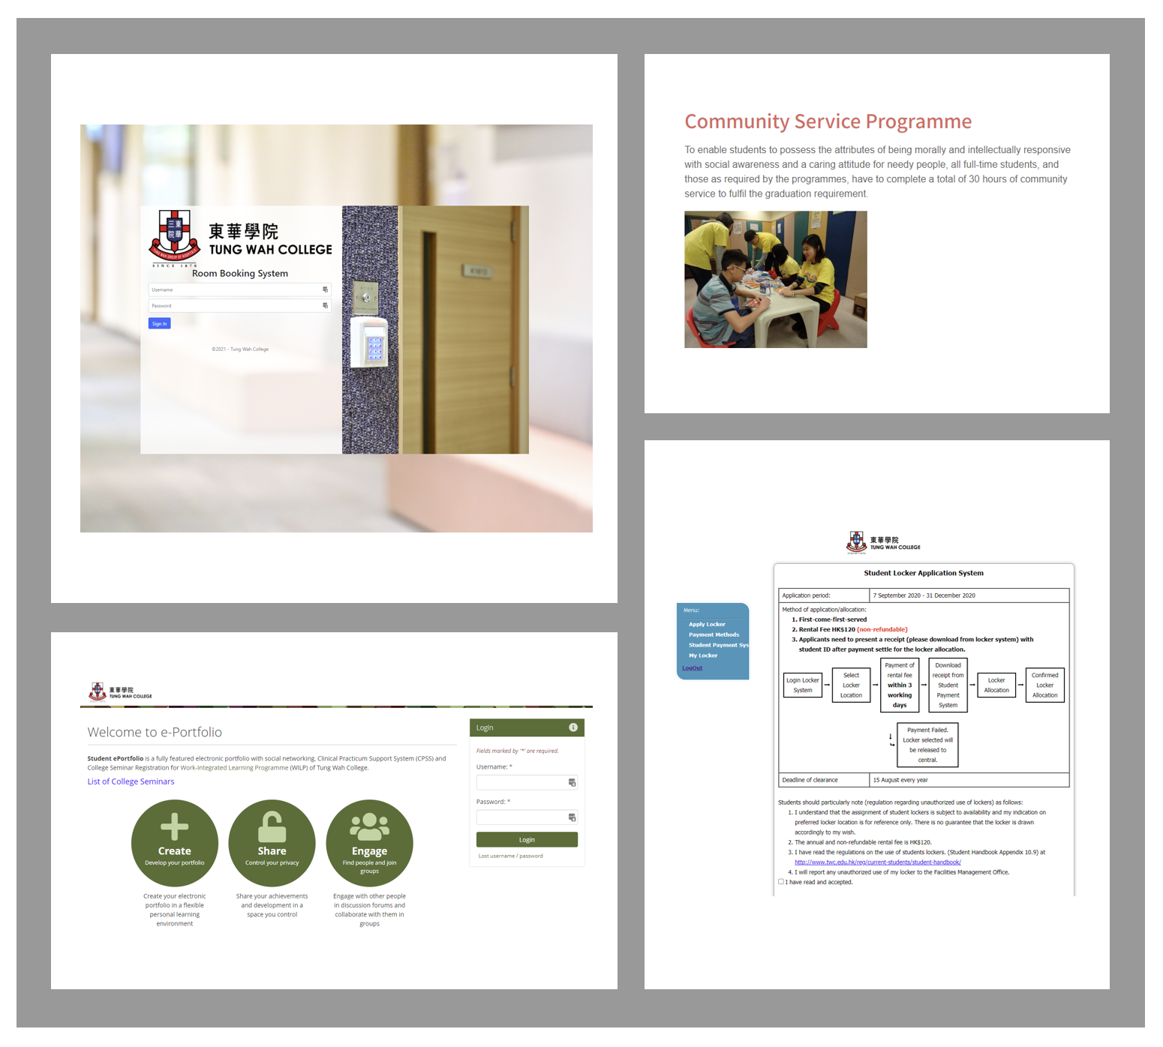
Other Student Systems
Room Booking System
Community Service Programme System
e-Portfolio System
Student Locker System

Slide 31
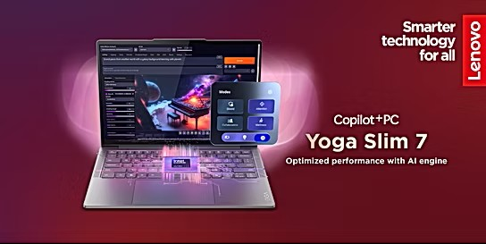


Notebook
Ownership
Program 2025
For Students, Staff and Alumni
Web Ordering Date: 8 Aug 2025 – 31 Oct 2025
https://www.twc.edu.hk/en/Administration_Units/itso

Slide 32
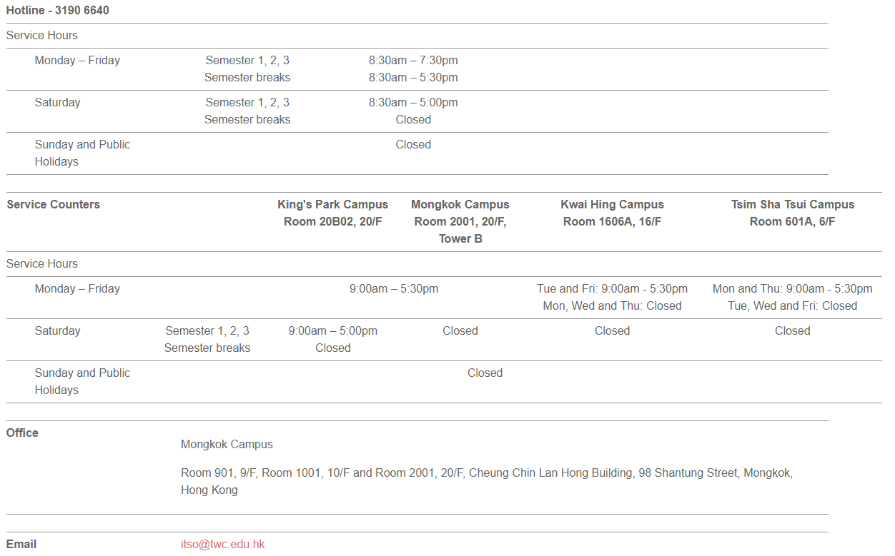
Contact Us

Slide 33


