Slide 1
Our Student Affairs Office
SAO strives to provide quality co-curricular programmes and various activities to develop students’ all-round potential and offer a rewarding learning experience.

Slide 2
Six Dimensions of
Students’ Personal Growth

Slide 3
Our services strive to cater to the 6 Dimensions of Students’ Personal Growth
Character Relationship
Spirituality Leadership
Commitment Horizon
Character
Relationship
Leadership
Horizon
Commitment
Spirituality

Slide 4
The Services Ladder of SAO: AAAA

Slide 5
Services Ladder: AAAA
Advancement
Advising
Adaptation
Arrival

Slide 6
Key Initiatives in 2024/25

Slide 7
Global Leadership &
Advancement Programme

Slide 8




Global Concern
Global Citizen
inner self……self discovery
explore outward and reflect inward
diverse mix of training methodologies and experiential learning opportunities

Slide 9


CORE CONCEPTS & OBJECTIVES
Students who have successfully completed the Programme are expected to be GLAP Champion before their graduation. The GLAP Champs will help serve the younger Glappers during their training period.
Global Concern
Global Citizen

Slide 10
GLAP: LEARNING OUTCOMES
Relationship Building with self and other
Horizon Widening Life Planning
& Connecting to &
the Globe Commitment
Self Understanding &
Personal Development
Relationship
Building with
Self & Other
Horizon Widening
& Connecting to the Globe
Life Planning
& Commitment
Self Understanding & Personal Development

Slide 11
GLAP 2024-25 TRAINING COMPONENTS
Global Awareness
in Action
Life Engagement Workshop-2
Advancement Camp
GLAP Dinner
Grounding & Goal Setting
To listen and to write Life Story
Celebration & Wrap up
Global issues Outreaching
7
9
With GLAP Champions & TWCGSA @
REGAL HK
3
5
2
4
6
1
High Table
Dinner
Social Awareness
in Action
Life Engagement Workshop-1
8
Local Issues Outreaching
Learning & Experiencing
one’s Inner World
(Mid-Project Assessment)
Outbound Study Tour
Mentoring Session
Life Reflection and Growth

Slide 12
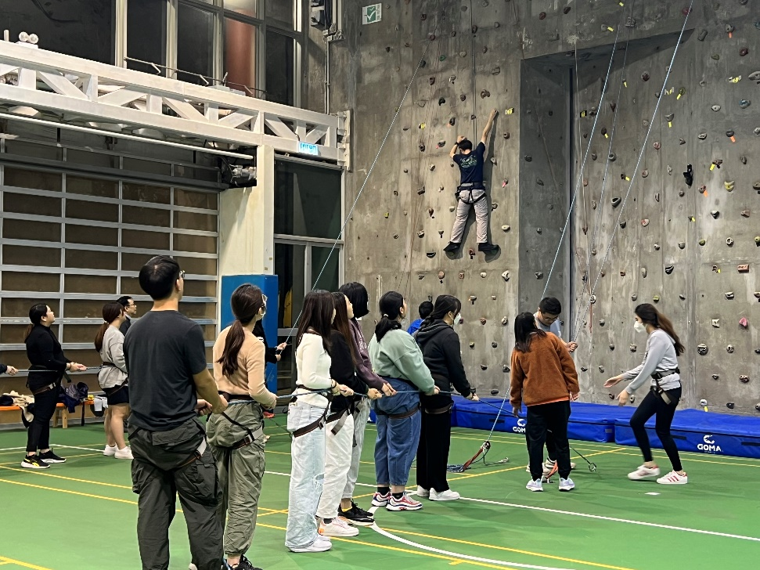
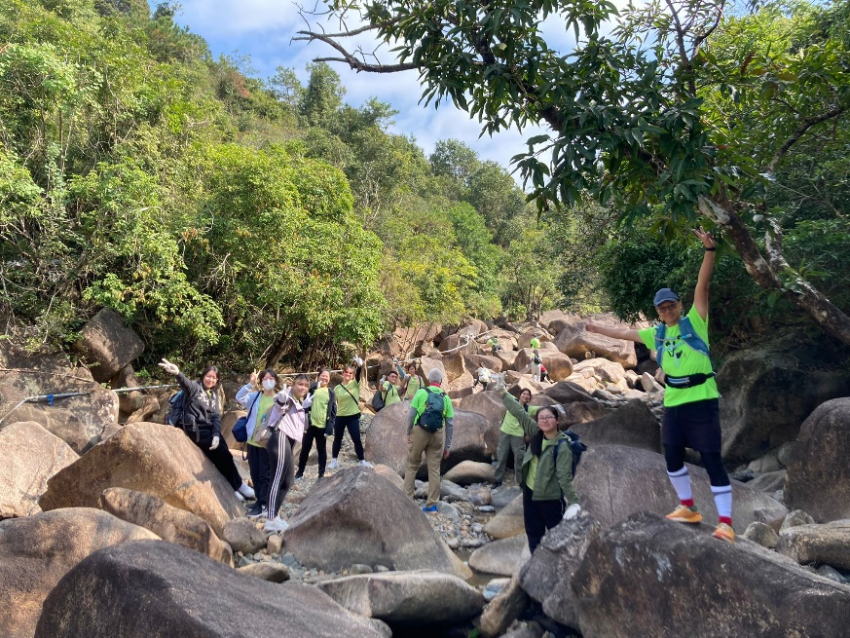
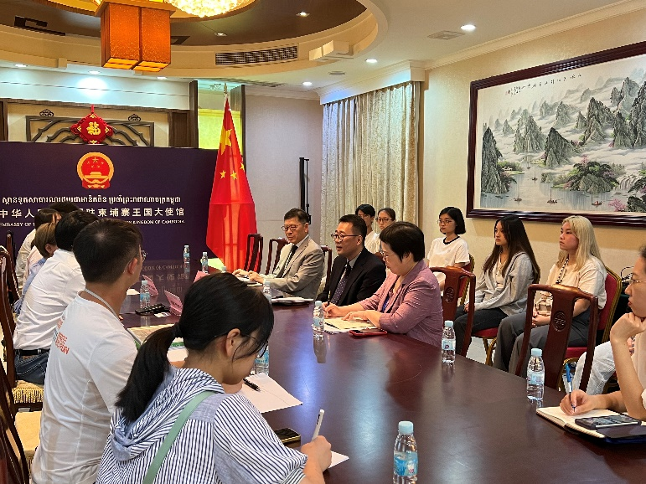
GLAP Training in AY2022/23 & AY2023/24
Meet up
Arrangement
Mentor
GLAP
Dinner

Slide 13
Tung Wah College
Global Student Ambassador

Slide 14

Tung Wah College
Global Student Ambassador
GLAP
TWCGSA
PMP

Slide 15

Tung wah college global student ambassador
objectives
Strengthen the sense of belonging to the College
Nurture a culture of civic engagement
Enhance an atmosphere of widening horizon
Learn to serve and serve to learn as an Ambassador for TWC
eligibility
All full-time students of Tung Wah College are eligible to apply for the programme !
250 Members Already!!

Slide 16
2. TWC GLOBAL STUDENT AMBASSADOR
Becoming an Ambassador
Honoured Ambassador
Peer Leader
Student Ambassador
Serving as Ambassador
Trainee Ambassador
Support the Ambassador Duty

Slide 17
Tung wah college global student ambassador
Global Awareness Outstanding Award
TWcGSA
Honoured
Ambassador
Student Ambassador
Trainee Ambassador

Slide 18

Tung wah college global student ambassador
Global Engagement Award

Slide 19

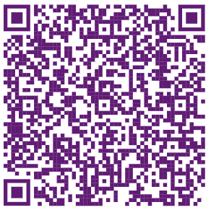
Tung wah college global student ambassador

Slide 20
Peer Mentorship Programme
(Students and Graduates Network)

Slide 21

Peer Mentorship Programme
PMP Advisors
Young Graduates
Peer Mentors
Senior Class Students
GLAP
TWCGSA
PMP
Mentees
New Students

Slide 22
Peer Mentorship Programme
Students and Graduates Network
Mentoring Groups
Student Mentees
Peer Mentors

Slide 23


Peer Mentorship Programme

Slide 24
Life Planning Centre

Slide 25
LPCENTRE
LIFE PLANNING CENTRE
One-Stop Services
Employers’ Survey
Students’ Career Planning Survey
LPC Online Platform
Internship Service
Employability Training
Career Advising & Counselling
LPC Comprehensive Toolkit

Slide 26
LPCENTRE
LIFE PLANNING CENTRE
One-Stop Services
Employers’ Survey
Students’ Career Planning Survey
Industrial-based Mentorship Programme
LPC Online Platform
Internship Service
Employability Training
Career Advising & Counselling
LPC Comprehensive Toolkit

Slide 27
LPCENTRE
LIFE PLANNING CENTRE
One-Stop Services
Employers’ Survey
Students’ Career Planning Survey
Industrial-based Mentorship Programme
LPC Online Platform
Internship Service
Employability Training
Career Advising & Counselling
LPC Comprehensive Toolkit

Slide 28
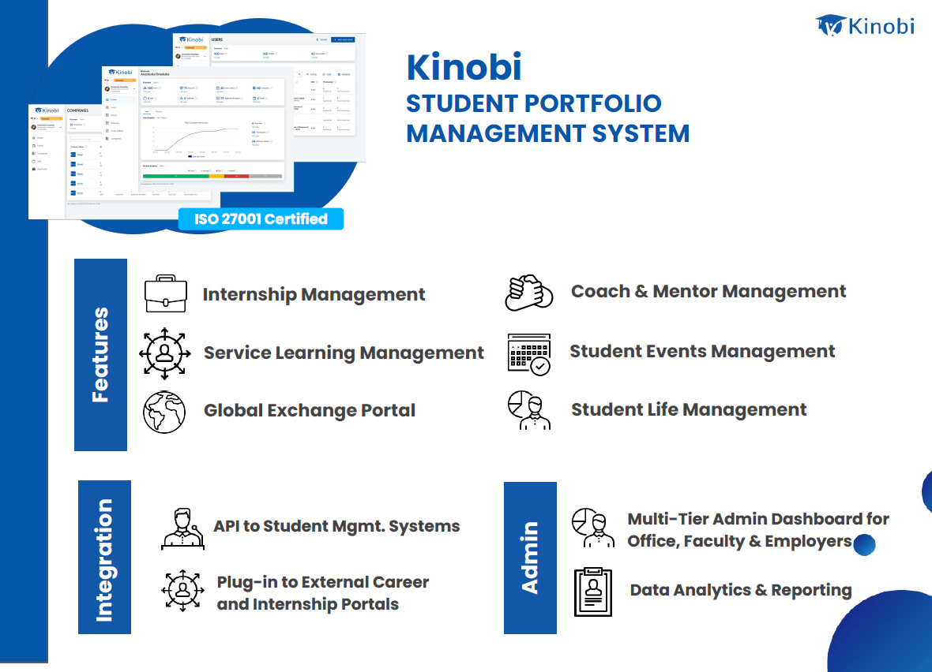
Life Planning Centre Portal

Slide 29
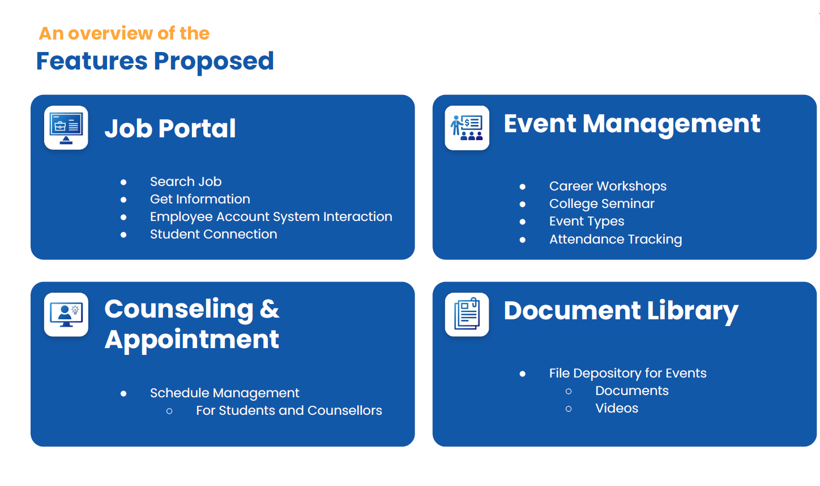
Life Planning Centre Portal

Slide 30
INTERACTION BETWEEN KEY PROGRAMMES
TWCGSA
PMP
GLAP
Life Planning Centre
Campus Wellness Tutor
College Seminar
SAO Activities
& Events

Slide 31
Non-Credit Bearing
Graduation Requirements

Slide 32
Non-Credit Bearing
Graduation Requirements
Students are required to complete 3 non-credit bearing graduation requirements administered by SAO and Programme of studies:
College Seminar
WILP Internship
Community Service Programme

Slide 33
Non-Credit Bearing
Graduation Requirements
1. College Seminar
Full-time bachelor’s degree students (including senior year entry students) are required to participate in at least EIGHT College Seminars before graduation.
Notes to senior year entry students:
- Be reminded to register and attend two College Seminars each Semester so as to fulfil the requirement.

Slide 34
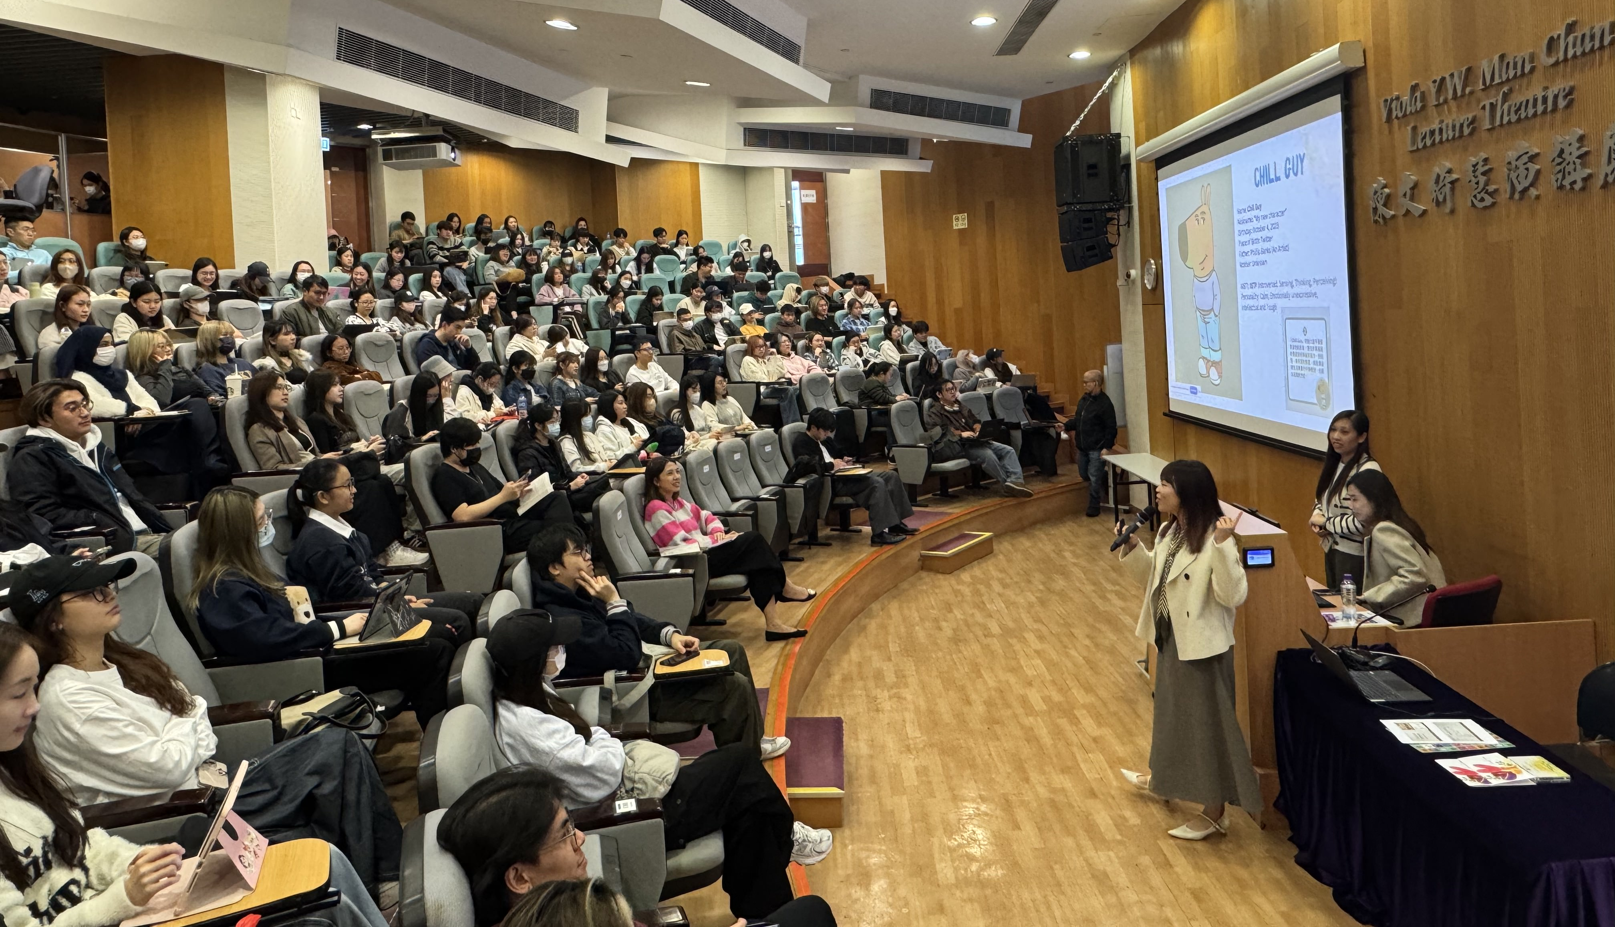
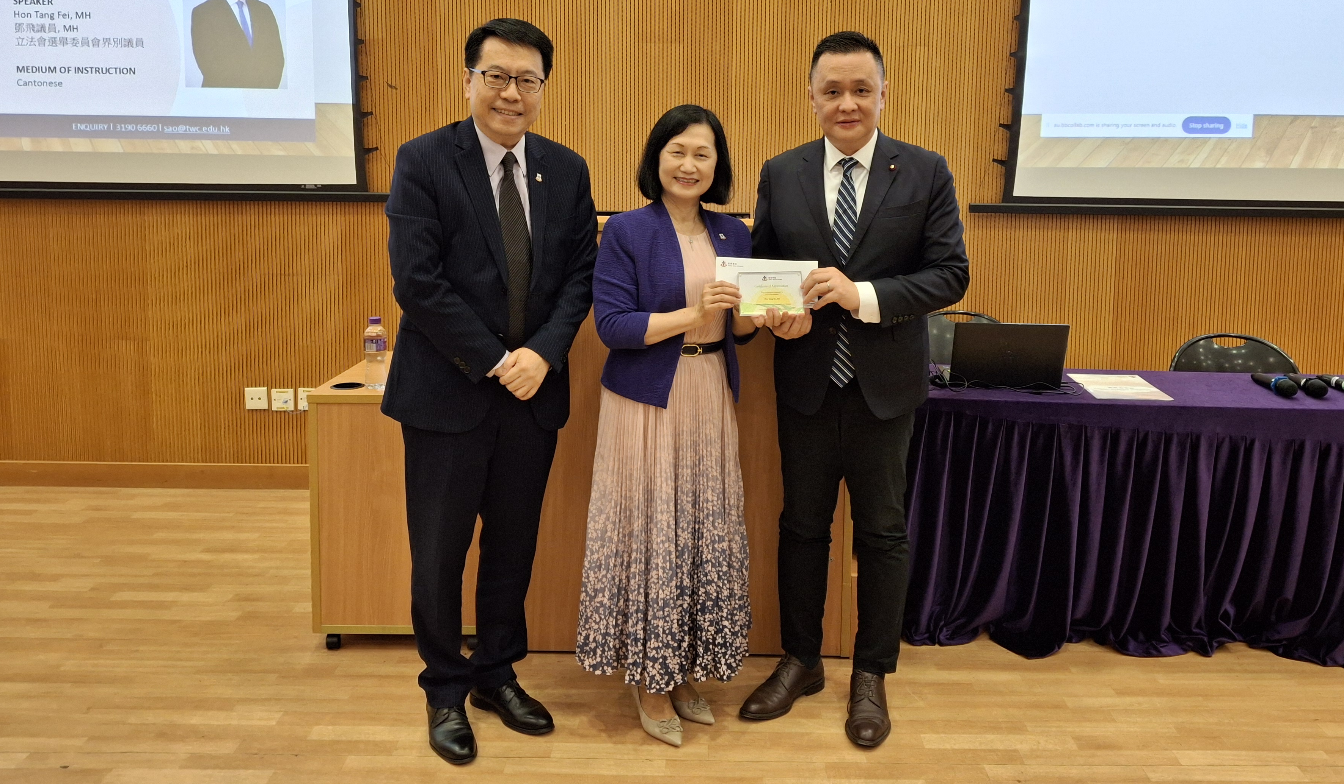
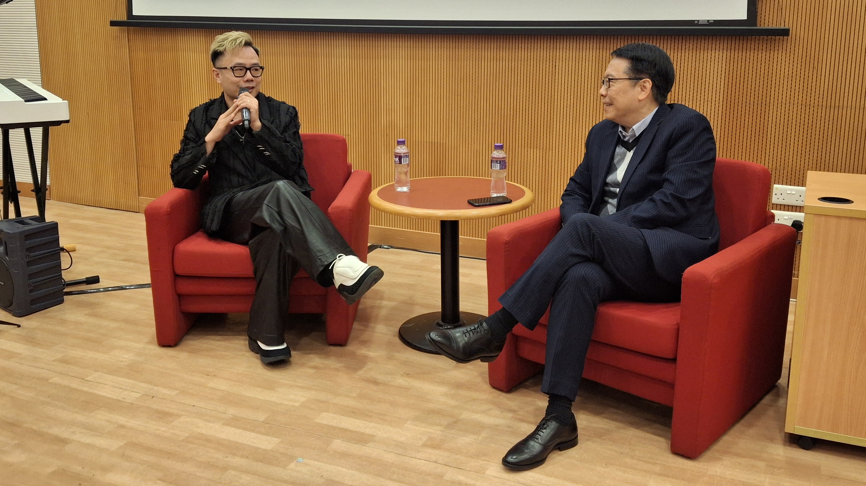
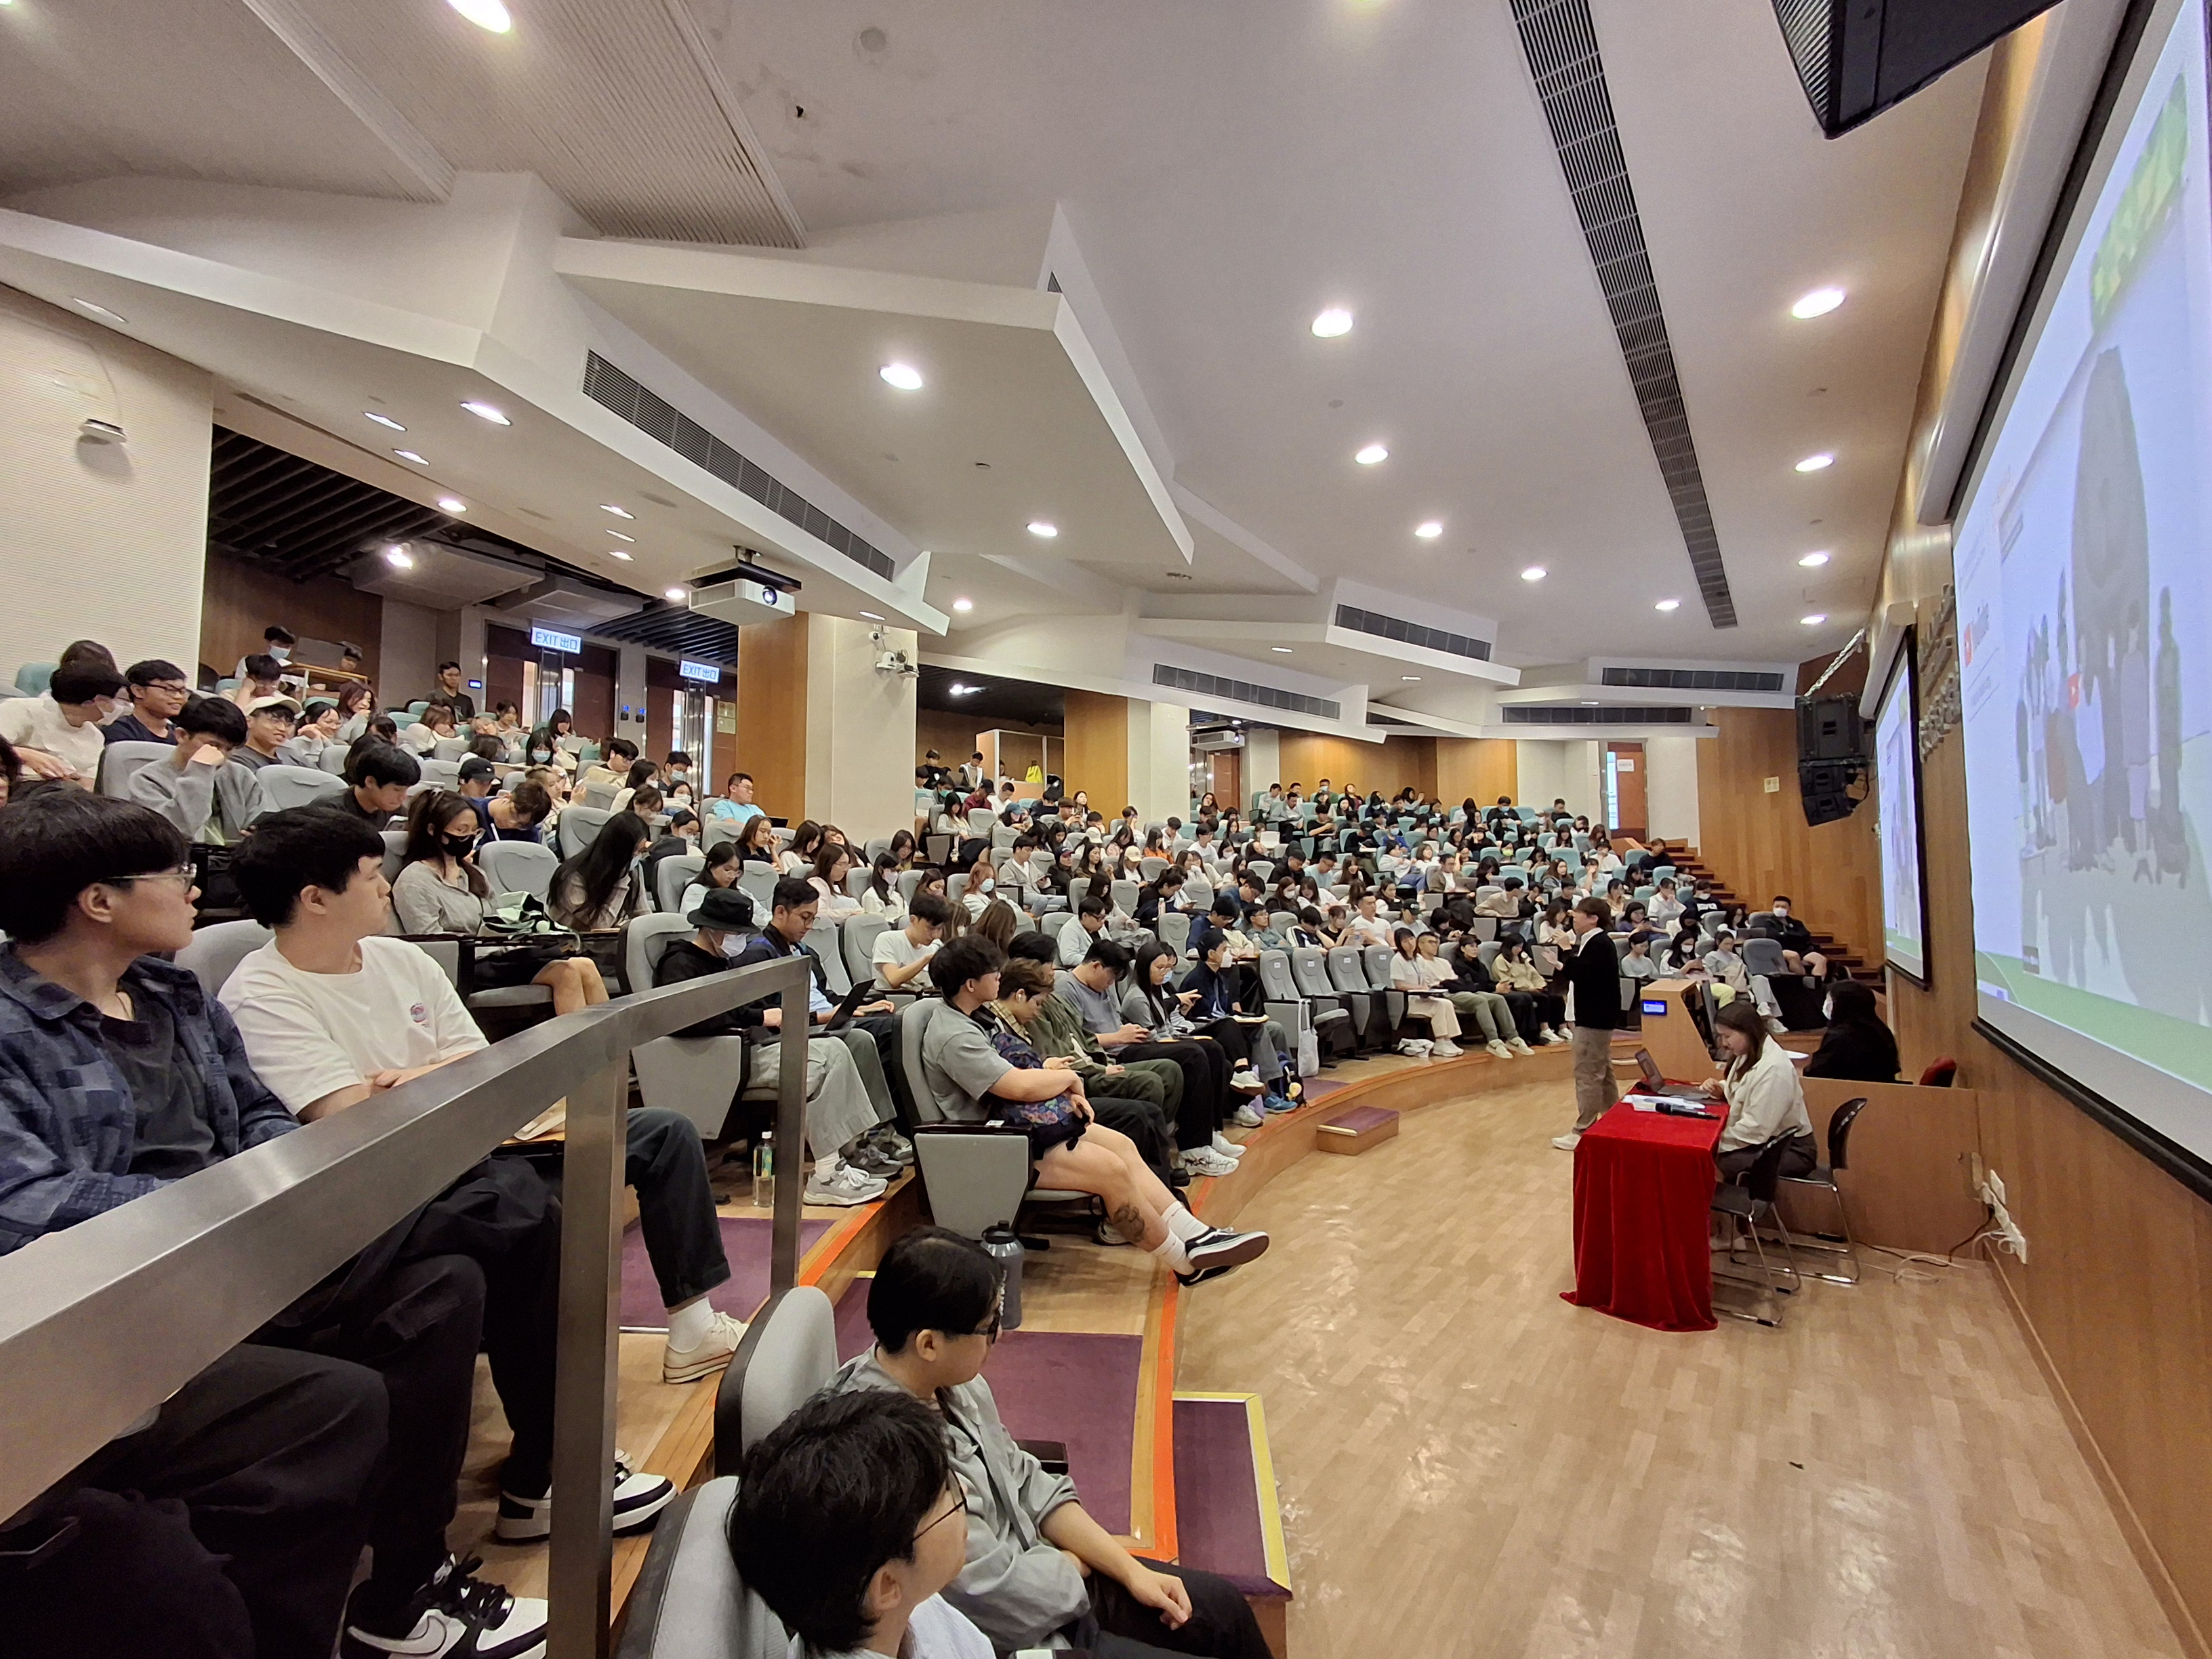
College Seminar

Slide 35
Non-Credit Bearing
Graduation Requirements
2. WILP Internship
The Work-Integrated Learning Programme (WILP) Internship involves work-based learning experiences that take place in an organisational context relevant to a student’s programmes of studies, future profession, the development of generic skills that will be valuable to that profession.
Full-time bachelor’s degree students are required to engage in either:
WILP Internship according to the individual programme
requirements, or
Practicum offered by the academic programme in which the
student is enrolled.

Slide 36
Non-Credit Bearing
Graduation Requirements
3. Community Service Programme
To enable students to possess the attributes of being morally and intellectually responsive with social awareness and a caring attitude for needy people, all full-time students have to complete a total of 30 hours of community service to fulfil the graduation requirement with the distribution of community service hours as below:
Recognised College-Based Service Hours ^{note1}: 10 hours maximum
Community-Based Service Hours ^{note2}: No limit

Slide 37
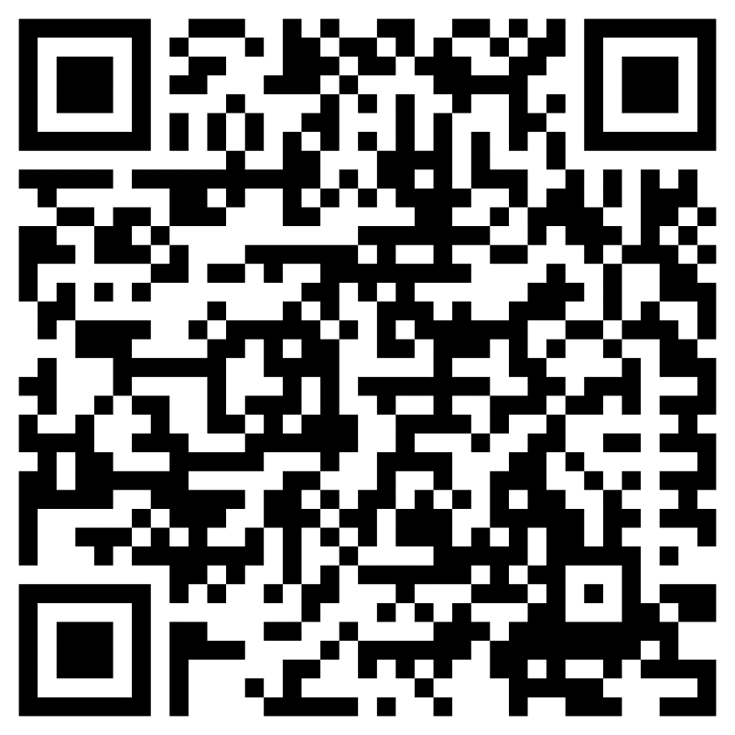
Non-Credit Bearing
Graduation Requirements
Students are strongly suggested to visit:
https://www.twc.edu.hk/en/Administration_Units/sao/our_service/Non_Credit_Bearing_Graduation_Requirements

Slide 38
Personal Growth & Counselling Services

Slide 39

Our Counsellors

Slide 40
We nurture a student community in meeting the
Essentiality for,
the Transformability in and
Inclusivity of
our students

Slide 41
We nurture a student community in meeting the essentiality for, the transformability in and inclusivity of our students
Students and Graduates Network
Non-credit Bearing Graduation Requirements/LPC
Student Wellness/PMP/ Inclusion Programme/ Student Bodies Advising
TWC Global Student Ambassador
Global Leader Advancement Programme
Student-centric

Slide 42
Integrative Approach
WILP Internship
WILP College Seminar
Life Planning Centre
JSSP, SA & SBs Advising
Wellness Programme
Student Rep Election
Scholarship & Award
Sports Development
SAO Services
GLAP
TWCGSA
PMP SGN
ENTREPN’SHIP
CEGE
LIFE REFLECTION

Slide 43
APPENDIX
TWC Welcoming Day for New Students

Slide 44
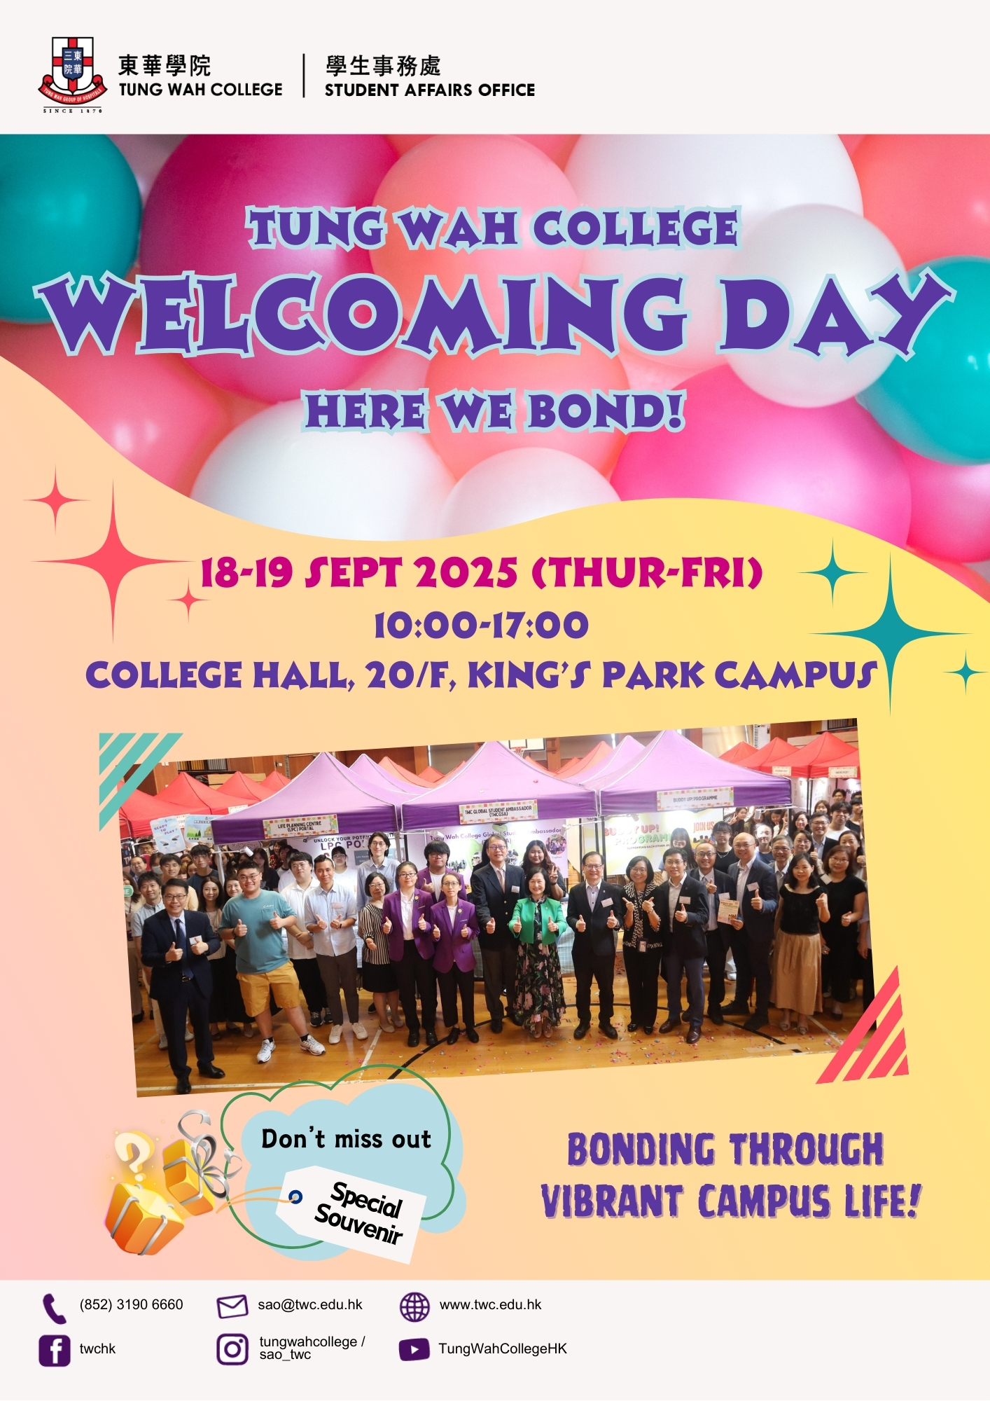
TWC Welcoming Day
for New Students

Slide 45












SAO CONTACT INFORMATION 学生事务处联络
Room 1901, 19/F, Ma Kam Chan Memorial Building, Tung Wah College, 31 Wylie Road, Homantin, Kowloon 九龙何文田卫理道31号东华学院马锦灿纪念大楼19楼1901室
Mondays to Fridays (except public holidays) 周一至周五 (公众假期休息) 9:00 a.m. – 5:30 p.m. 上午九时至下午五时三十分
Student Services 学生服务：3190 6660 24-hour manned Security Control Room 安控制室：3190 6610 (24 hours 24小时)
(852) 3585 2675
sao@twc.edu.hk
@TWC SAO
@sao_twc

Slide 46
End

